Slide 1
Special Educational Needs and Disabilities
Notes:
Emma

Slide 2
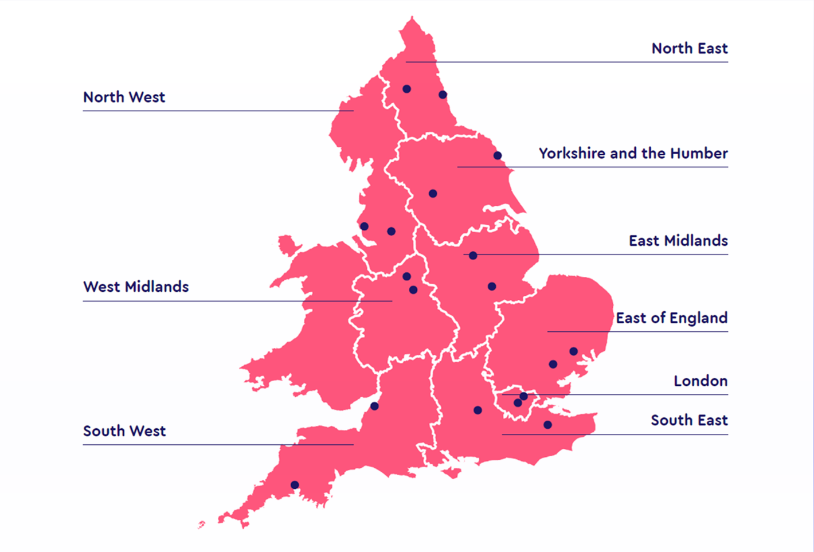
Notes:
Emma to introduce the hubs in this presentation and where they are situated in the country

Slide 3
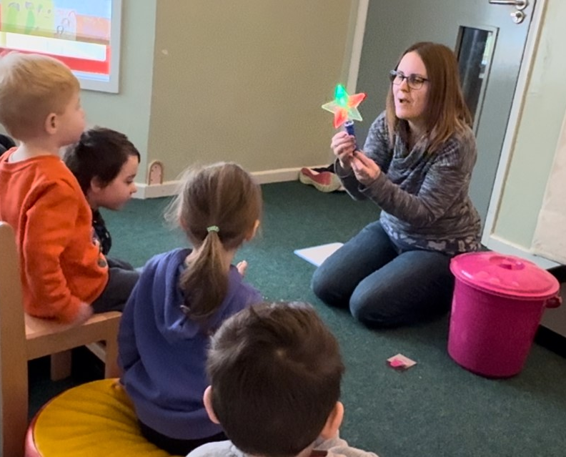
Intent for all Stronger Practice Hubs
To upskill the early years workforce to enable better outcomes for all children.
To build a more Inclusive early years for children with SEND, with positive outcomes for children, practitioners and families
Improving ALL practitioners confidence in supporting inclusion in their settings
To share knowledge and expertise in all areas of SEND, to give practitioners confidence to fulfil their role in supporting all children.
Notes:
Emma to discuss the main aims and intent for SPH in regards to SEND – see slide content

Slide 4
SEND in the Headlines
Notes:
Angela
This slide shows some of the SEND information that is hitting the headlines. In Early Years we are seeing a significant rise in the number of children with SEND coming into our settings. Not only are the numbers increasing, the range of needs are growing and becoming more complex. It’s no longer speech and language delay, grommets, global developmental delay and autism, it is a vast spectrum of needs and disabilities. Early Years settings need support from education, health, social care and the voluntary sector. The supportive work alongside the education and care of the child can be very time-consuming. If we all believe that our youngest children deserve the best start in life then we must invest in Early Years, these are the foundation years where we can truly make a difference to children’s life chances. Practitioners, parents and children should not have to face a postcode lottery for services and resources. We need consistency and appropriate funding across all authorities.
Note from Theresa :
'If we all believe that our youngest children deserve the best start in life then we must invest in Early Years, these are the foundation years where we can truly make a difference to children’s life chances. Practitioners, parents and children should not have to face a postcode lottery for services and resources. We need consistency and appropriate funding across all authorities. '

Slide 5
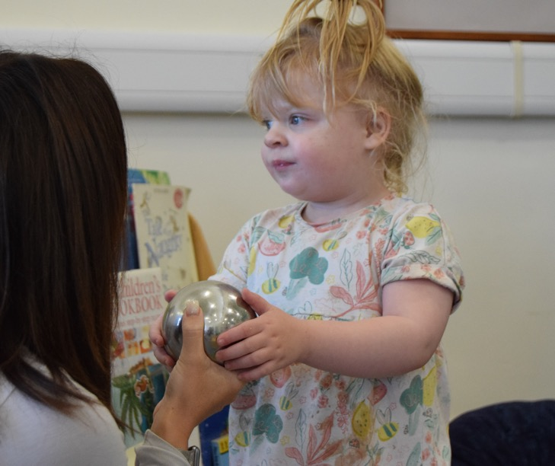
Meeting the Needs of our Locality
Triage service for settings to access as the need arises – advice, guidance and support, or just a sounding board.
Early Years SEND training based on the DfE - A Celebratory Approach to Working with Children with SEND (Giving additional support in the Early Years).
Liaising half termly with all local authorities in our Hub region.
Forging strong links with the DfE Expert and Mentor programme
SEND network meetings, blogs, webinars and case studies
Specific SEND training for Childminders
Notes:
Angela – In the East Midlands region we have worked hard to engage partners and local authorities to gain a good understanding of the challenges being faced. All have spoken about the rising numbers and complexity of children with SEND. We know this is a national struggle, but every day counts in a child’s life and we must strive to get it right. We have set up a triage service for settings to contact us to ask for support, direction or just to sound us out. We have also established half termly meeting with leads from each local authority to consider the needs in their areas and plan for support across the region. Through the Stronger Practice Hub, we have developed a two day training course on SEND for Early Years, this course draws on the content in the DfE document - A Celebratory approach to Working with Children with SEND. The sector are asking for more training. We have also planned to offer Network meetings, webinars, blogs and to share some case studies. We hosted a childminders conference and they asked for specific SEND training for childminders.
We have heard from settings that the links between stronger Practice Hubs and the Expert and Mentors programme can have a powerful impact on practitioners and settings and that they want more of this.

Slide 6
Work to be Celebrated
We have developed a strong partnership across the Hub region working closely with named leads in all of the Local Authorities.
Through the Stronger Practice Hub, Pen Green Centre have written and disseminated a 2 day SEND in Early Years training course.
Linking the work of the Stronger Practice Hub with the DfE Expert and Mentors programme to make a difference to practice.
Notes:
Angela – Developing strong relationships across the region is critical as this can help to build an understanding of what is available, share good practice, consideration of the challenges and possibly become a driver for change. This takes time and building trust is paramount. SEND is high on the agenda for many Local Authorities due to lack of funding, lack of places/provision, rising numbers and the number of families who are unhappy with the offer. Something has to change! Through the Stronger Practice Hub we are able to pull some of this information together.
Through the Stronger Practice Hub, we have disseminated a two days SEND in Early Years training course. This course celebrates children with SEND and highlights inclusive practice, it also challenges staff to find a way! The initial course was oversubscribed and it was very well received by the practitioners in our locality who were able to attend. We are going to offer this out to a wider audience in the coming months.
Pen Green Centre lead on the administration of the DfE Expert and Mentors programme and we have seen the impact of using both the offer of the Stronger Practice Hub and the Experts and Mentor programme to offer tailored support to practitioners and settings. Settings are telling us that they need more of this to improve practice and to give all children the best start in life. Make every day count, sadly for some children, tomorrow could be too late!

Slide 7
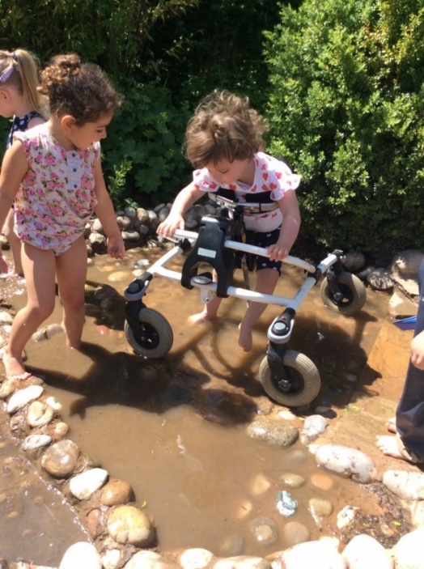
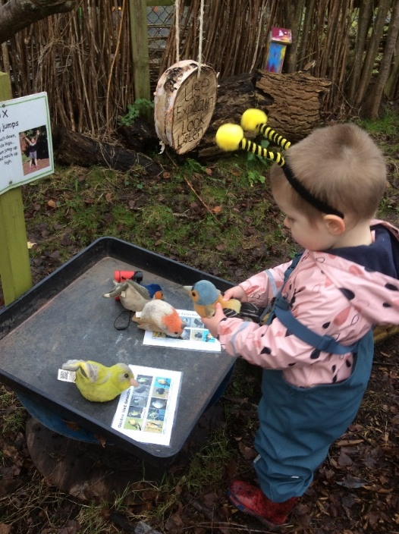
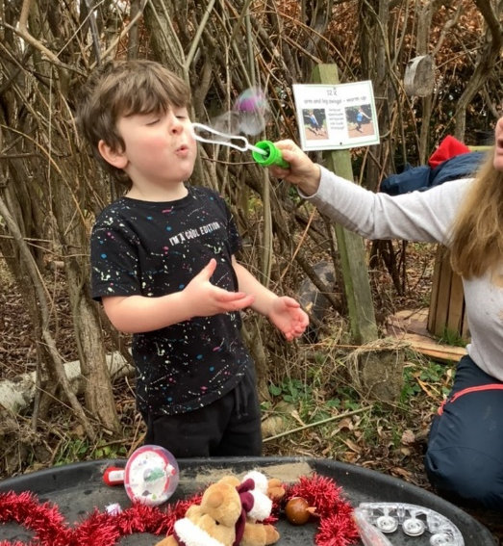
What is the National Picture?
1 in 5 parents of children with SEND have said they have been turned away from an Early Years Setting of their choice
In 2022, a survey of providers said 27% had no more spaces for children with SEND (Ref for survey, Dingley Promise Practitioner Survey Oct, 2023)
Recruitment difficulties are still holding back settings ability to be able support inclusion in their settings
Coram: only 18% of local authorities believe they have enough provision for all children with SEND in the early years
Notes:
Lee
Over recent months, it has become clear through surveys the rising need for children with SEND. The Dingley’s Promise Survey in October 2023 showed that not only are 1 in 5 parents being turned away but the fact that 27% of Early Years Providers had no more space for children with SEND. This mixed in with the ongoing recruitment difficulties that local areas are facing all impact the ability to offer inclusion for children with SEND in settings.
Coram completed their own survey, and it was noticed that out of all the Local Authorities, only 18% feel they have enough Early Years inclusive provision for children with SEND.

Slide 8
Meeting the Needs of our Locality
We invited all settings across the Thames Valley Home Region to complete a survey.
When asked what the training needs and priorities were in their setting 52 % said SEND and Inclusive Practice
Notes:
At the Thames Valley Hub we invited all the Early years settings in our home area Reading, Windsor & Maidenhead, Wokingham and West Berks Local Authority areas, to complete a survey in order to help us to identify what the sector felt they needed in terms of support and how they felt that support would be best delivered. 52% of those who returned the survey set SEND and Inclusive practice as a priority. When asked how they felt support would be best delivered the sector asked for flexible, virtual training options that allowed managers to be creative in when and where staff gained access. This was particularly true of our childminder colleagues, who said they often find training difficult to access.

Slide 9
Work to be Celebrated
Strand 1 A partnership with Dingley’s Promise which has allowed us to offer their Inclusion Programme of short courses free to all our practitioners including childminders | Strand 2 Hosting Open events at both our Lead setting Blagdon Nursery School and at our local Dingley Promise specialist Early Years Centres, to promote SEND networking and high quality SEND practice | Strand 3 Nominating ‘Through My Eyes’ to be a research programme with EEF (Education Endowment Foundation) . ‘Through My Eyes’ is a focussed programme , looking at how to best support children with social communication difficulties.
Notes:
Gemma - At Thames Valley EYSPH we have looked focused our work on three strands of SEND support
As a Thames Valley hub partner setting Dingley Promise is able to offer their Inclusion Training free to all early years practitioners in our hub reach area. This training provides flexible, online, courses tailored to supporting different elements of SEND. The course subjects have been developed from feedback across sector (you said we did method), and varied training approaches within the course are used to meet a number of learning styles
As a hub we also offer Open events at our partner settings with a clear SEND focus. Last term both Blagdon Nursery School and Dingley Promise Reading opened there doors to welcome practitioners from across the sector. This provides not only for practitioners to see how SEND support is offered in our settings, but also an opportunity to network with each other.
And finally we nominated ‘Through My Eyes’ to be a research programme in partnership with the EEF. Through My Eyes is focussed programme, looking at how to best support children with social communication difficulties.

Slide 10
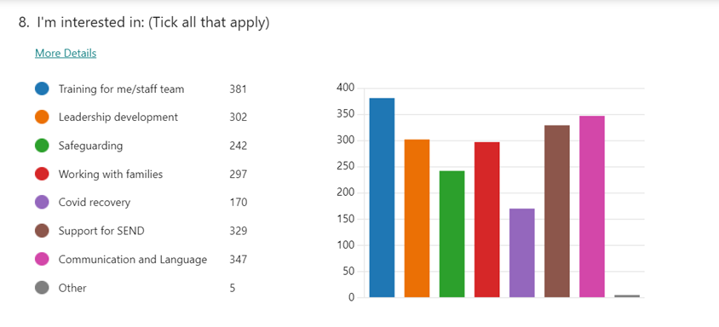
Meeting the Needs of our Locality
In Derbyshire 18% of pupils are receiving SEND support, compared to 16.3% across neighbouring LA’s
In Nottinghamshire, the number of children under 5 needing an EHCP has risen by 56% from 2016.
The sector indicated in our regions that training on SEND was their second priority behind Communication and Language.
Notes:
Emma- ~The Derbyshire and Nottinghamshire Hub covers the LA’s for Derbyshire, Nottinghamshire, Derby City and Nottingham City. I firstly wish to give some context to my hub locality. In Derbyshire there is a higher level of children, in fact just under 2% more than neighbouring LA’s being identified as having a special educational needs or a disability. In Nottinghamshire the number of children under 5 needing an EHCP has risen by 56% since 2016. With this information it is not a surprise that when we asked our new hub members what they are need support with, SEND was a high priority. Discussions at networks also enforce that early years practitioners are finding themselves with more children with SEND attending their settings, with some colleagues feeling unprepared at how to support individual children and high levels of children with ASD. It was with this information we built our SEND offer for the region.

Slide 11
Work to be Celebrated
‘Diamond Nugget’ videos on our Youtube channel delivered by a Speech and Language Therapist and SEND teacher to support simple techniques to use with children with SEN.
SEND conference in the Autumn Term 2024 with key speakers and workshops aimed at the main areas of need from the sector.
Supporting practitioners with using the Dingley’s Promise resources
Notes:
Emma- We decided that we wished to create ‘diamond nugget’ videos that would be informative and useful in providing simple but effective strategies to support children with SEND. We worked with a SEND school teacher and a Speech and Language therapist who firstly discuss the strategy and how it can be useful before demonstrating this in practice with children. The videos are short to ensure quick learning, as we understand that not every practitioner has extensive amounts of time to carry out CPD.
You have already heard about the fantastic programme called Dingley Promise and we are currently cascading this programme to our colleagues as well as planning an Autumn SEND conference later this year. This conference will be an opportunity to be inspired, attend workshops that are specific to areas of SEND, as well at interact with a SEND market place hosted by colleagues that support all aspects of SEND across the hub area. The aim of the conference is for colleagues to leave with an extensive list of strategies to support children with SEND, as well as an awareness of the SEND support systems in their locality.

Slide 12
Meeting the Needs of our Locality
Voices of experts and mentors working with settings through the DFE Covid Recovery programme.
Feedback from evaluations, voices from the sector.
Verbal feedback when networking with the sector at conferences/ webinars.
Liaising with local authorities and hearing challenges.
Notes:
Diane – to explain how we ensured we met the needs of our locality.
We worked alongside the experts and mentors in our area, gathering feedback from practitioners in the settings they were working with.
Every event we put on as a hub we included questions for future events. A consistent request was to provide the sector with more training on supporting children with SEND in their settings.
This message was also consistent from feedback from LA advisors who reported that settings are struggling with challenging levels of SEND in their settings and need further training and support to gain more confidence and strategies to use to support individual children.

Slide 13
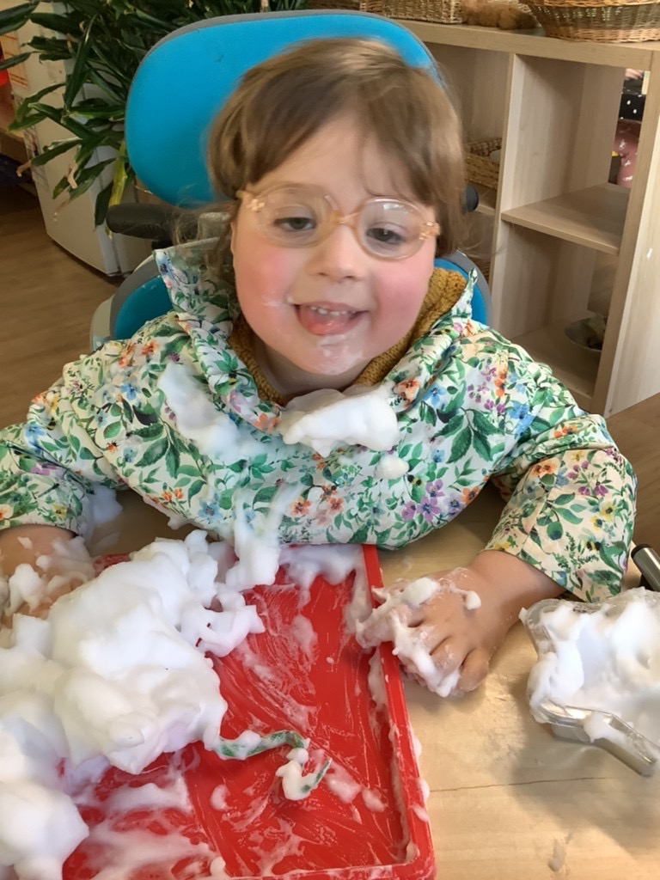
Work to be Celebrated
Early Years in Action – Practitioners visiting the setting to observe practice and network with SENDCo’s to share practice and problem solve together.
Supporting Children with SEND Webinar in collaboration with the Local authority. Community of practice approach after key note talk, explaining LA offering.
Send Forums – collaborative session focusing on SEND Code of Practice statutory duties and entitlements, as well as speakers from local charity and specialist school.
Bespoke support to settings – supporting wellbeing of staff and systems in place to support children and families with SEND, as sector is finding SEND challenging.
Experts and Mentors supporting settings to problem solve, enhance practice and improve outcomes for children.
SEND Conference – Celebration of SEND and the work Early Years Professionals do everyday. Supporting the sector to collaborate and adjust mindset shift in relation to SEND.
Notes:
Natasha to talk through EOESPH celebration of SEND, giving examples of positive feedback, support implemented through the SPH, practice examples and feedback from the Early Years Sector.

Slide 14
Our Impact
Dingley Training (Thames Valley SPH)
100% of practitioners who have completed the post-training survey say they feel more confident in supporting children with SEND
98% of learner believe they can support more children with SEND as a result of their training
77% are committed to making a change in their setting
Feedback from our open events;
‘Through My Eye’s Programme
Made us reflect on our routines, and understand the need for our routines to be more tailored to individual children's needs’
‘Since the open session we have reviewed out resources and ordered more resources for our outside area’
Following the open evening we have looked at our staff's training needs, and several have booked onto the hubs SEND training programmes’
Notes:
Lee - The Dingley’s Promise Training has had a really positive impact on our Hub. The confidence and knowledge of our Early Years Practitioners, Childminders and settings has increased as a result of the training.
To date 242 Early Years practitioners have accessed the training through the Stronger practice hub, with 14% being childminders.
With the popularity of the training within our Hub Areas, we have also been able to offer open events to enable practitioners to not only develop their own academic knowledge and confidence but to also be able to see a Dingley’s Promise setting to see it all put into practice.
*Read the quotes.
Gemma - The Through My Eye's programme is being co-funded as a development project with the EEF which will have three longer term benefits to the sector, firstly it is an opportunity to refine the programme through development and evaluation, secondly, it will support settings with accessing evidence-informed professional development that could improve their practice and thirdly it may start to close evidence gaps identified by EEF when summarising evidence for the early years evidence store.

Slide 15
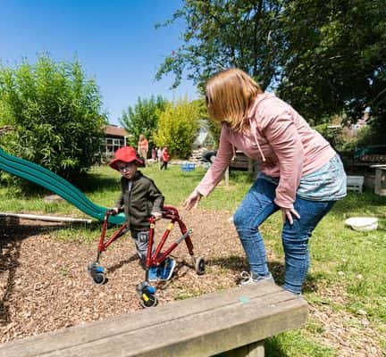
Our Impact
The support given through all channels has upskilled the early years sector and given practitioners confidence to support the individual needs of children with SEND, however there is still an immense amount of work to be done to ensure all children achieve their full potential.
The SPH’s have given a platform for the early years sector to voice their worries and concerns and be able to support each other through the networks established.
Notes:
Lee - The support given through all channels has upskilled the early years sector and given practitioners confidence to support the individual needs of children with SEND, however there is still an immense amount of work to be done to ensure all children achieve their full potential.
The SPH’s have given a platform for the early years sector to voice their worries and concerns and be able to support each other through the networks established.

Slide 16
What is the National Picture?
1 in 5 parents of children with SEND have said they have been turned away from an Early Years Setting of their choice
In 2022, a survey of providers said 27% had no more spaces for children with SEND (Ref for survey, Dingley Promise Practitioner Survey Oct, 2023)
Recruitment difficulties are still holding back settings ability to be able support inclusion in their settings
Coram: only 18% of local authorities believe they have enough provision for all children with SEND in the early years
Notes:
Early Years settings are faced with some difficult decisions about whether their setting is the right place for the child, will they receive appropriate funding, is there support available from the local authority or other partners and are staff equipped and trained to meet the needs of the child to give the best start in life.
The Early Years sector is still facing a recruitment and retention crisis. We are aware that DfE are working on a recruitment campaign , but we still have a long way to go in attracting people into the sector as a long term career.
I’m sure we all know that there are not enough Provision from children with SEND in Early Years. Again there is no consistency, with Local Authorities making there own decisions about what is needed and what they can afford.
Note from Theresa:
If referencing the new recruitment campaign please ask delegates to use and promote the campaign rather than suggesting it doesn't go far enough . There's a toolkit here that might help with this if needed: https://earlyyearscareers.campaign.gov.uk/wp-content/uploads/sites/182/2024/02/Do-something-Big-campaign-toolkit.pdf it's worth noting that it has been launched and isn't so much that 'DfE are working on it'

