Slide 1
Supporting Professional Development
How the Stronger Practice Hubs are supporting the professional development of the early years sector

Slide 2
Building Reflective Settings
Every blog, webinar, showcase and resource are invitations to reflect on practice.
Being flexible in our offer has been a priority so we have a wide reach.
Gleaning the best bets from research and making approaches accessible to practitioners.
Notes:
We are all committed to supporting a culture of reflection in settings so they may enter a cycle of CPD to support the progress of their children. The EYs SPHs have partners across the EYs sector to ensure training is delivered by varied practitioners. Participants are especially thankful to receive training from those who have direct experience of teaching our youngest learners in a variety of settings.
Many of our hardest to reach practitioners are short of time so every resource, webinar, course and showcase, however brief is designed to provide practical tips that can be implemented at no cost.
It is our main aim however to encourage the use of the evidence store, the child development training and our training offer to support settings with their CPD cycle.

Slide 3
Professional development to support C&L: starting a process not an event
Supporting children to become better communicators is one of the most powerful things we do as early years professionals.
Helping everyone to understand that the role of the adult is crucial. Children learn more when engaged in conversations than when just exposed to words, the social-interaction is key (Rowe, 2022).
It is important practitioners understand the professional development needed to develop high quality interactions and effectively support communication and language.
Notes:
Communication is central to children's learning, thinking and emotional wellbeing. We know children's CL development was impacted by the pandemic. Practitioners in our region were seeing this play out in their settings and were asking for support.
Early language ability is one of the strongest predictors of later development through school and in life. Strong communication and language skills in the early years are linked with success in education, higher levels of qualifications, higher wages and better health’ (The Institute of Health Equity, 2020, p. 38).
As highlighted in the EEF guidance report Preparing for Literacy: “When done well, high quality interactions often look effortless but they are not easy to do well and professional development is likely to be beneficial.” We know that engaging children in multi-turn interactions that are responsive and adaptive to each individual child requires a change in behaviour. It requires practitioners to learn strategies and then use them in their daily practice. This is not an easy change to make. In order to support this change and increase the quality of teaching and learning in the long term, we need to draw on what research evidence says makes PD most effective. (Long term programme with training input and mentor support)
"A quality learning experience for children requires a quality workforce. A well-qualified, skilled staff strongly increases the potential of any individual setting to deliver the best possible outcomes for children." EYFS Stat Framework
To ensure that the professional development we provide actually has a lasting and sustained impact on EY practice, creating high quality workforce , who deliver quality learning, we need to refer to the EEF’s Effective Professional Development guidance report which highlights the essential building blocks – or mechanisms – which can help to bring about changes in practitioner behaviours and improve child outcomes. The new Guide to Effective Professional Development in the Early Years has been a crucial document for the SPHs and we have drawn on it heavily when designing our training and supporting networks and settings

Slide 4
Professional development to support C&L: starting a process not an event
Our aim is to help EY professionals get started on their journey to providing high quality teaching that supports communication and language
We produce a series of resources and events that create a bridge from the research-evidence to daily practice, in contexts that they recognise. We used the evidence store to shape all our work.
Signpost to sustained programme of PD offered through the SPH
Showcase or CM stay and play with modelling
Blog, article or resource
Webinar
Notes:
Becky Francis "Research shows that the Covid-19 pandemic has led to unprecedented disruption to early years settings, negatively impacting children’s learning and development. This has been further exacerbated by workforce challenges such as recruiting and retaining early years professionals—especially those who are qualified."
Exemplify evidence-informed practice, share what effective PD looks like, signpost ways to get more sustained PD.
The journey from blog/resource, to webinar, to showcase/ CM stay and play, to a sustained programme of PD offered through the SPH programme

Slide 5
Early Years Conversation Project
A sustained programme, focused on evidence-informed professional development.
Designed to improve early years professionals’ understanding and practice in supporting children’s communication and language development.
29 hours of training over 8 months (blended online and in person). Settings will be provided with 'wrap-around' support from an expert mentor.
Notes:
We have been developing evidence-informed practice and professional development to support communication and language since 2018
Manor Park Talks - Newham Communication Project – Early Years Conversation Project
This has allowed us to create exemplification, training and printable resources to support the sector.
The SPH programme has funded a large efficacy trial of our CL project and provided high-quality free training to 112 settings in London.
Research evidence from the EEFs GR but also our own pilot funded by the EEF (MPTs) - had an effective strategies review at the same time (UCL:IOE). Using GR on implementation and PD to inform training design.
Research evidence must sit at the heart of professional development
The project is developed on the basis of the EEF PD guidance report. Underpinned by a new review of evidence that seeks to move the evidence-base forward.
The work and learning from these iterative processes has allowed us to create exemplification for supporting CL in the form of blogs, videos and articles. It has allowed us to train our own staff team, our local network of PVIs in Manor park and then wider in the LB of Newham. This has created a community of practice and practitioners who can confidently use the strategies and reflect on their use with colleagues.
Contributing to the evidence store (us and partner childminders)
Our sustained PD programmes have allowed us to create spin-off webinars and resources for the SPH
We are also delivering EYCP to 112 settings in London. Being independently evaluated to look at the impact of the PD on practitioners pedagogy and confidence and children's outcomes. Contributing to the evidence base around what works for 2 year olds. Made possible by the SPH programme.

Slide 6
Language Learning and the Outdoors
Many members asked for support in enhancing their outdoor learning spaces.
We made the link between language learning and the outdoors as there is lots of research to support CL approaches.
Showcases and in person training were especially successful in terms of practitioners feeding back feeling inspired to make changes and adopt research informed ideas.
Questions raised over risk sparked useful discussions amongst participants. Learning from each other. Sharing experiences. Raising importance of precise language to support PD and risk assessment.
Notes:
We chose to make the link between outdoor learning and communication and language due to interest from our members in developing practice outside and the research which highlights the importance of communication and language practices that make a difference.
As with many areas we have developed over the years in our own settings, we have found the areas our staff are the least confident in are often the areas that need the greatest support. Being outside came up as an area practitioners felt less confident about. We noticed adult language sometimes being less specific in the outside space. So, we felt it was a good time to share the successes we had had with outdoor experiences having a positive impact on language learning incorporating what we now know from the research that teaching vocabulary, language and interactive reading really makes a difference to a child's development. It can add seven months to a child's development.
Practitioners visiting our outdoor spaces were very grateful to see principles in action. All participants said they were taking ideas away to implement and had fruitful discussions, problem solving with the group.

Slide 7
Outside- A Preferred Learning Space for Many
In our many years of experience we found lots of our children with SEND and EAL have uttered their first words in the outdoor environment.
Quality Adult Interactions
Language Acquisition
Outside
Notes:
Another area we have been asked to offer training on is SEND.
Linking the outside with a safe space for children with additional needs to thrive.
Lots of non-educational research has linked time spent in natural spaces with higher levels of wellbeing. A clear link between nature and wellbeing has been made. The explicit effects of outdoor learning in a child's development is research that has not yet been conducted on a wide scale. What we can share are our own experiences of helping children communicate and develop new skills in their preferred learning space. Outside, a child often feels less under the spotlight and freer to experiment with a language they have not yet mastered, for example. Sharing our resource that supports language learning in natural spaces was an invitation for participants to go back to their settings and plan for specific vocabulary and language to be taught in the outdoor area.

Slide 8
Using Clear, Specific Language Outside
Combining research with what we know about outdoor learning.
Language Matters
Interactive reading outside- acting out stories
We devised a resource to support language learning related to nature and the seasons to support practitioners with children's fascinations.
Notes:
To support staff in our own setting, we created a resource that followed the seasons drawing upon the immediate natural surroundings on site. Practitioners asked for the resource to be better able to name and talk about the plants, shrubs and trees in our local environment. For each season, month and term there is a section for practitioner knowledge, key language to use with the children and key texts to share with the children to reinforce the same chosen language.
One childminder commented, "you have done the work for us, thank you". Considering her very busy day it was a relief for her to have some ideas that could really support her in refining her curriculum. "It was a joy to visit Charles Dickens today. It inspired us to go back and discuss our current provision and the changes we would like to make. Thank you for your time and we look forward to further events" "this resource will be very useful in supporting the development of language related to nature learning. Thank You"

Slide 9
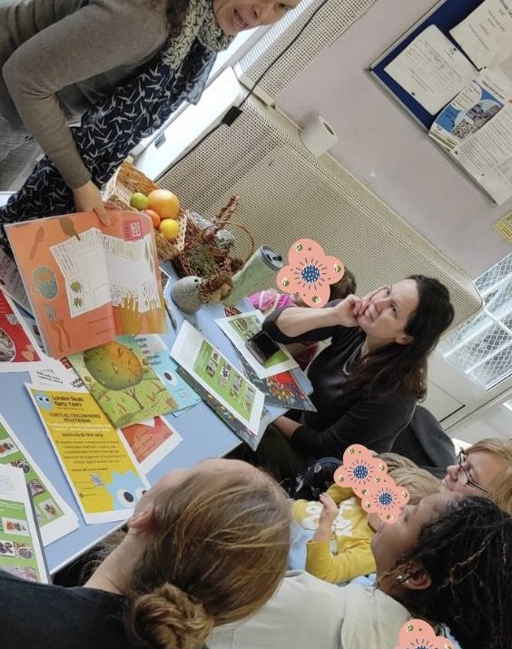
Taking Training to Childminders
Offering bite size training and resources to childminders at regular stay and play groups has been welcomed.
Emphasising the three most effective approaches to support communication and language in the outdoors including interactive reading.
Notes:
A sector that has felt isolated in recent times has welcomed the drop-in visits we have offered at their existing sessions. This has worked best where small groups have been able to access brief training whilst a colleague looked after their children. This did not impinge on their time. We offered resources and examples of high quality texts to complement the nature learning. Childminders in our experience are out and about lots so very keen to further develop their knowledge of the natural environment.
Adapting training to the different audiences has kept us on our toes.
There are quite a few childminders who favour an early Saturday morning session for a more in depth webinar so we have ensured these are also part of our offer.
Pushing what we know about language learning and development is what we continue to bring our points back to.
Feedback has been really positive. Eg
"Thank you, very informative session."
"Thank you so much it was very interesting and lots of information I can use and apply in my setting."

Slide 10
Heart - Midlands Early Years Stronger Practice Hub Responding to need
West Midlands practitioners requested:
Support for teaching early maths
Support for children with SEND
EYFSP 2023 Data Maths:
West Midlands 75.1%
National 77.1%
Notes:
Talk about how we found out what settings/practitioners want.
Link to outcomes/data.

Slide 11
Using the evidence – supporting Early Maths
Evidence consistently shows that educators can implement approaches that benefit young children’s mathematical skills and knowledge. The EEF’s Early Years Toolkit estimates that effective early numeracy approaches typically increase children’s learning by about seven months.
Using multiple approaches together could aid children’s mathematical development. Facilitating mathematical language underpins other approaches.
To support effective maths teaching, educators need to know how children’s maths skills develop, how to teach maths (pedagogy), and have knowledge of maths itself. The Evidence Store focuses on approaches for teaching. This overview page briefly introduces how children’s maths skills develop.
The EEF Early Years evidence store supports 'Teaching the association between number and quantity' as 'The approach of teaching association has a positive effect on early mathematics.
EEF Early Years Evidence Store
Early Mathematics
Approaches and practices to support mathematics in the early years
Child development
modules
Maths – Number
Recommendation
Counting collections
You can provide collections of objects for children to count. For example, you might provide a box of large buttons or counters. Children will enjoy practising their counting skills as they select and count their favourite buttons or counters, with adequate supervision at all times.
Notes:
What the evidence tells us is effective maths teaching and learning.

Slide 12
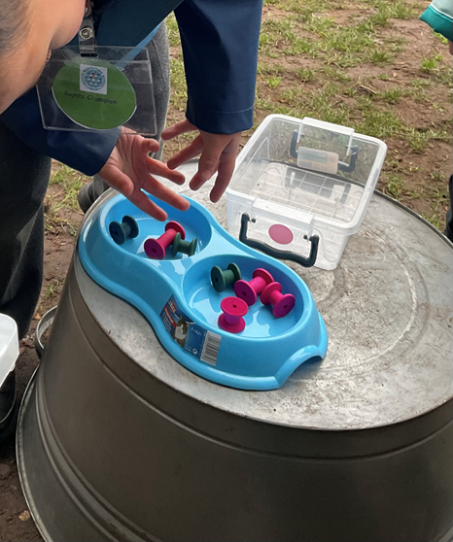
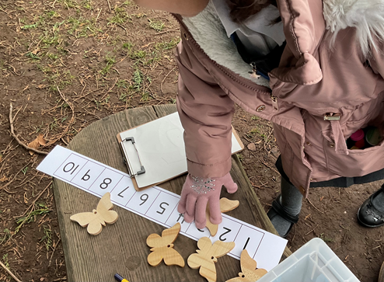
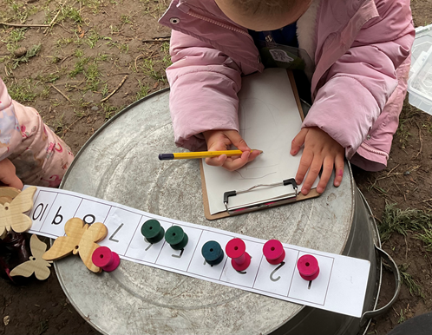
Counting Collections
Counting Collections is a ‘hands-on’, practical approach to developing young children’s enjoyment and understanding of numbers, which aims to provide all children with essential early number learning in counting and subitising, addressing differences in their home or wider number experiences so all children have a firm foundation for future mathematics learning.
Counting collections has been a great programme for our children to be involved in. We have found that the children's accuracy when counting has improved and they are beginning to work on other areas of practical maths which will be beneficial moving forwards to primary school, such as comparing numbers, number bonds and subitising or estimating how many they have in a group.
For our staff, the programme is easy to implement and follow. Most importantly, our children love counting together with their key worker. Creating an environment where children can practise counting and build a love for maths is so important. Goodway NS
Notes:
Counting Collections
Practical, hands on – easy to implement without excessive time out or training.
Links seamlessly with the DFE Child Development Maths Modules and EEF Early Years Evidence Store

Slide 13
Using the evidence – supporting practitioners with SEND
Key Findings
The research findings highlighted that whilst over 70% of SENCOs were either extremely confident or very confident in identifying SEN, there was concern that less experienced members of staff were receiving no specific SEN training.
NASEN Report (2020)
Identifying special educational needs in the early years: Perspectives from special educational needs coordinators.
We will identify need at the earliest opportunity in high-quality early years provision
Excellent early years provision can play a key role by identifying needs early and putting the right support in place so that children can progress. Research has found that high-quality early years provision for children significantly decreased the likelihood of a child being identified with SEN in later years
We will explore ways to upskill early years practitioners in undertaking the EYFS two-year-old progress check and encourage further integration to join-up across education and health services.
We have heard that early years practitioners can struggle to accurately identify where a child may have SEND.
SEND Review: Right support, right place, right time
Government consultation on the SEND and alternative provision system in England (2022)
Notes:
What the evidence tells us supports practitioners with SEND.

Slide 14
NASEN Golden Key
SEND CPD for key people in early years
The role of the Key Person in an Early Years setting is vital. This eight-week training programme will upskill EY practitioners to identify and provide for the needs of all children in their care. This involves identifying individual needs, building a trusting relationship with them and their parents/carers and daily interaction with children to gain a holistic understanding of their likes, dislikes, interests, and individual learning and development needs.
The Golden Key has a very clear and realistic purpose to give all practitioners the additional skills, knowledge and confidence to plan those reasonable adjustments that will make a big difference to all children. Weoley Castle NS
Notes:
Training for Key Workers in strategies to support children with SEND. Practical ideas.

Slide 15
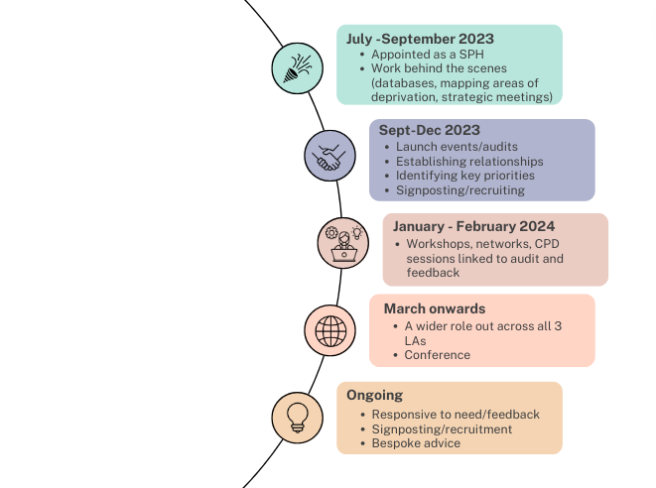
Timeline
Notes:
One of our first priorities was to develop relationships with local authority and strategic partner groups to find out what PD was already on offer and how we could add or enhance this to improve the outcomes of children. Building these relationships was imperative to us as partnership working is something we have strived for from the very beginning. We found out during these meetings that SEL/PSED was an area that practitioners in the North East wanted more support with so during our launch events we added a section on this which I will discuss further in the presentation. Another priority was to find out about each practitioner/setting so during the launch events, we also rolled out our audit to find out the strengths and areas of development/need of practitioners in Northumberland, Durham and Newcastle. We then analysed this audit to determine our core offer of PD for the three areas we cover, starting predominantly in our home area but with all PD opportunities open to all areas we cover and we have found some very keen practitioners willing to travel quite a distance at times! We are now strengthening our offer further and rolling out the PD across all 3 areas so that is geographically spread with the aim to reach the more deprived areas/settings whilst doing so.
During all of this we signpost to the other DfE recovery programmes and raise the profile of the EEF's evidence-informed approaches and practices.

Slide 16
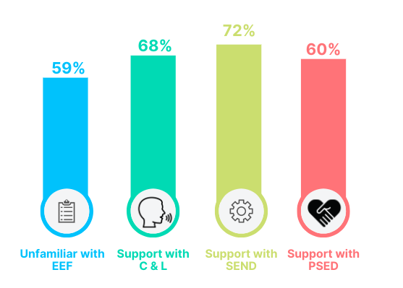
Our Audit...
Notes:
Our audit demonstrated four main areas to initially focus on.
**Read out the figures**
73% of childminders alone were unfamiliar with EEF resources
We have worked hard to provide a range of webinars, networks, workshops, PD sessions, blogs and case studies to address the findings from our audit and everything we do is linked to the EEF resources to raise practitioners awareness of this key and valuable tool. For the purpose of this presentation I am going to focus on the work we have done in relation to PSED and SEL which also helps support the area of SEND too.

Slide 17
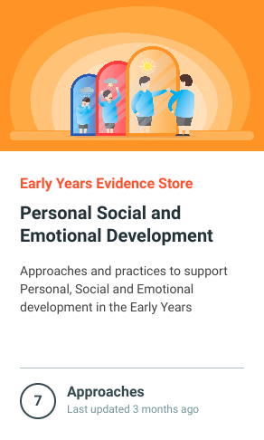
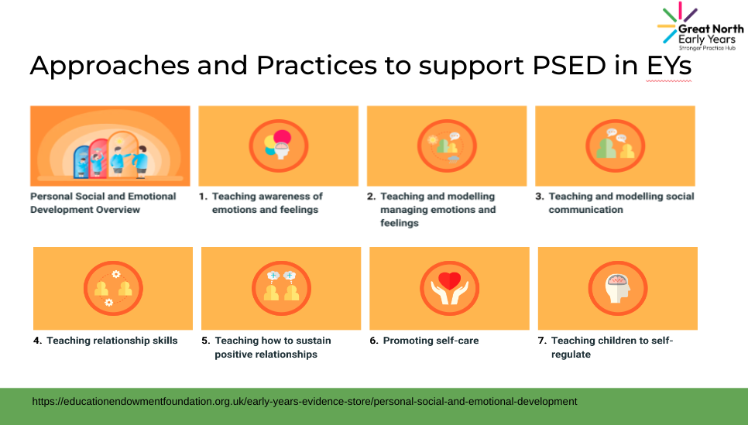
Notes:
60% of practitioners in our audit requested support with PSED and even more so verbally during our launch events and via emails requesting bespoke advice.
Our work on PSED/SEL started during out launch events. Intelligence from local authority advisors, strategic partners and practitioners on the ground were indicating this was a key focus area.
I worked with an early years leader from Town End Academy to put a case study together. This early years leader had been working with Town End Research School to unpick the PSED evidence store and put these approaches in to practice. I supported this school in Early Years last year and I witnessed first-hand the impact of this work on the PSED/SEL skills of the children but particularly with the most disadvantaged. So we worked together on a case study with a very specific layout. We gave some key background information about SEL/PSED, we found out practitioners current challenges which was really valuable then we delved into the Early Years Toolkit and the Evidence Store and how to use them. This really helped raise the awareness of these EEF resources and we had several comments on how useful it was to see how to use both.

Slide 18
"A very informative and useful session, very well presented."
"I will use the EEF more now, it is not as scary as I thought!"
Notes:
I then focused on each approach and 'what the evidence tells us' and then the EYs Leader explained the evidence-informed practice she has in place as a result of this. This really brought the evidence to life and gave practitioners several ideas that they could take back to their setting to implement. At the end, we shared the impact within this setting so that practitioners could clearly see the benefits that the implementation of these approaches have had.
This way of showcasing the EEF evidence store and evidence-informed practice has been highly successful and praised as it is clear, informative and well presented.

Slide 19
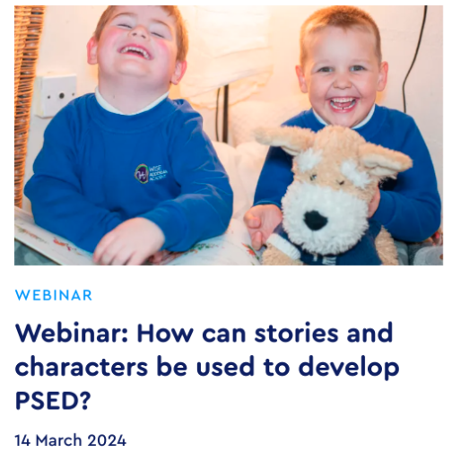
"I will definitely be implementing some of the evidence-based strategies that were talked about today."
Notes:
We rolled this format of presentation out across all launch events. From this, we had several requests to deliver this again but in more detail so we held a 2.5 hour PD session which also looked at the EEF's 'guide to implementation' and the EEF's 'guide to effective professional development in EYs'. This also included a tour of the setting which again helped bring all of the evidence-informed approaches/practices we discussed to life. We were also invited to speak about it at a conference and we have further sessions/webinars planned in in response to ongoing requests. A blog has also been written to supplement this and a webinar is being held in March focusing solely on stories to develop PSED in collaboration with Town End research school as a result of feedback from these sessions where practitioners requested more information around this area.
I will now hand you over to Sally.

Slide 20
Child Development modules
Stronger Practice Hubs have been pivotal in sharing information with the sector around the DFE online child development modules.
Available
1: Understanding child development
2: Understanding brain development
3: Supporting children's personal, social and emotional development
4: Supporting language development in the early years
5. Supporting physical development in the early years
6: Mathematics
To follow
7: Effective curriculum and assessment
8: Supporting individual differences and needs.

Slide 21
Child Development modules
Sector Feedback:
I now like the fact that you can choose which module you would like to access first. This helped with my settling development plan targets and individual staff training plans.
“ I enjoyed the module it reminded me about the importance of scaffolding learning”
I found the modules really useful. The module on brain development really made me think about how I interact with the children.
I have been out of early years for a while working in schools. It was good to be reminded of my training.
I loved the maths module. It was great!

Slide 22
Bring evidence informed practice to the sector.
" This is a wonderful resource that I was not aware of before attending a Stronger Practice Hub network. I am going to share these videos to the team"
"A great resource to strengthen the use of evidence at my nursery"
"Like the videos, short and kept my attention and made me think about how I can enhance my day to day practice"
"Bring evidence to life, makes evidence more accessible"

Slide 23
Contact
eysph@londonsouthtsh.org
abrighterstart@sheringham-nur.newham.sch.uk
greatnorthsph@wiseacademies.co.uk
midlandssph@birminghamearlyyearsnetworks.org

