Slide 1
Encouraging Evidence-Informed Practice
How evidence is used and developed by Stronger Practice Hubs to support the early years sector

Slide 2
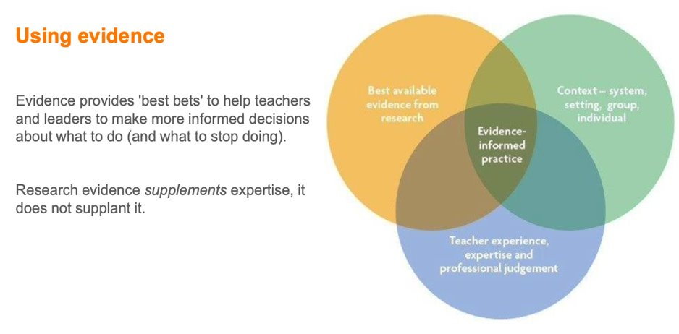
Notes:
When we say evidence, what do we mean? We are talking about evidence generated through research
What is research evidence? research evidence is the communication of findings from a study that answers clear research questions through planned and deliberate processes for collecting and analysing information. It is important to note that not all evidence is drawn from research.
Evidence supplements expertise. It does not replace it. We take the best available evidence from research and consider the vital components of context and experience, expertise and professional judgement. Represented in this graphic

Slide 3
Evidence is our 'best bet'
'This is where education research can make a real difference. Using evidence can help to create great learning opportunities for all children, particularly those from socio-economically disadvantaged backgrounds who we know stand to benefit most from high-quality early education.'
EEF Chief Executive, Professor Becky Francis CBE
Notes:
Becky quote: We now have more insights than ever about what works to support children before they start school. Early years professionals can use this information to identify “best bets” and initiatives that have previously been successful, giving insights that can bolster their expertise and guide their decision making around what might be effective in their setting. Not only that, but findings from research help them to weed out approaches that don’t show any evidence of impact, so that resources can be diverted towards strategies that are likely to be more fruitful.
Evidence gives us information about how effective different approaches are likely to be on ch’s learning and development. It can help us make decisions about how to make the most of the adults in our settings to create great learning opportunities for all our ch, particularly those from socioeconomcally disadvantaged backgrounds.
It helps us to make wise decisions, supports us to know what to focus on and crucially perhaps what to stop doing!!

Slide 4
Menu of evidence inputs, formats and sharing
Notes:
Becky quote: We now have more insights than ever about what works to support children before they start school. Early years professionals can use this information to identify “best bets” and initiatives that have previously been successful, giving insights that can bolster their expertise and guide their decision making around what might be effective in their setting. Not only that, but findings from research help them to weed out approaches that don’t show any evidence of impact, so that resources can be diverted towards strategies that are likely to be more fruitful.
Evidence gives us information about how effective different approaches are likely to be on ch’s learning and development. It can help us make decisions about how to make the most of the adults in our settings to create great learning opportunities for all our ch, particularly those from socioeconomcally disadvantaged backgrounds.
It helps us to make wise decisions, supports us to know what to focus on and crucially perhaps what to stop doing!!

Slide 5
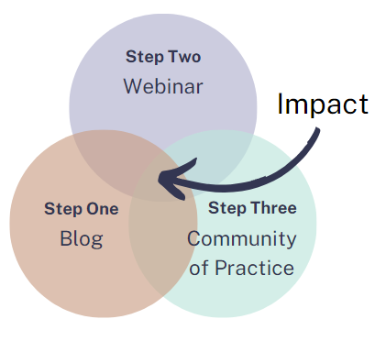
3 strand approach to sharing evidence
1. Blog with links to evidence as a taster
2. Webinar with an in-depth look at the chosen evidence alongside practical examples of how the evidence can be implemented in setting
3. Community of practice to feedback and share good practice, share small wins and any difficulties encountered

Slide 6
Blog
Ensure evidence is from a credible source
A hook to invite people to read
Peer reviewed to ensure the blog is clear and accessible (and interesting!)
Call to action at the end – join our webinar to find out more
Shared with hub network, SPH website and social media

Slide 7
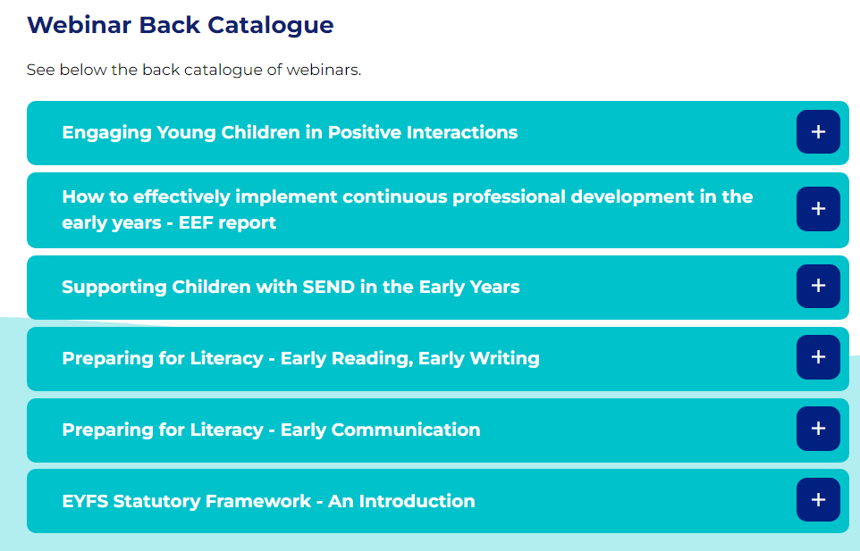
Webinar delivery
Ensure timings are accessible to the sector – one during the day and a repeat twilight
Share links and reminders several times in the days prior to delivery
Accessibility – captions enabled
Well-paced content
Opportunities to ask questions
Recording available after the event
Link to further evidence e.g. guidance, evidence store

Slide 8
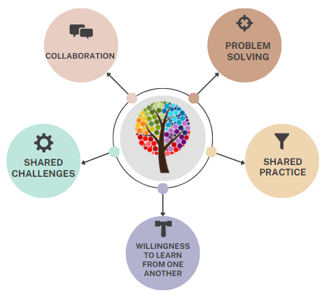
Communities of Practice
Practitioner led
Collaborative, safe space to share
Professional altruism – share what is working well
Opportunity to work through any problems encountered with supportive group
Opportunity for further bespoke support for your setting from the hub

Slide 9
Spotlight on Leadership - Effective PD
Represent, inform and unite the sector,
Meeting a local need using a credible sources
Strand 1: Social media, newsletter, blog and Network taster
+
+

Slide 10
Spotlight on Leadership - Effective PD
Strand 2: Webinar Wednesdays
Accessible timings
Sequential support
Approach in action
Leaderships tools to use in practice
+

Slide 11
Spotlight on Leadership - Effective PD
Strand 3: Sustainable support through a community of practice.
Peer led support (NPQEL/Expert/Mentor).
Revisit, discuss and embed.
Affirmation and collaborative problem solving.
+

Slide 12
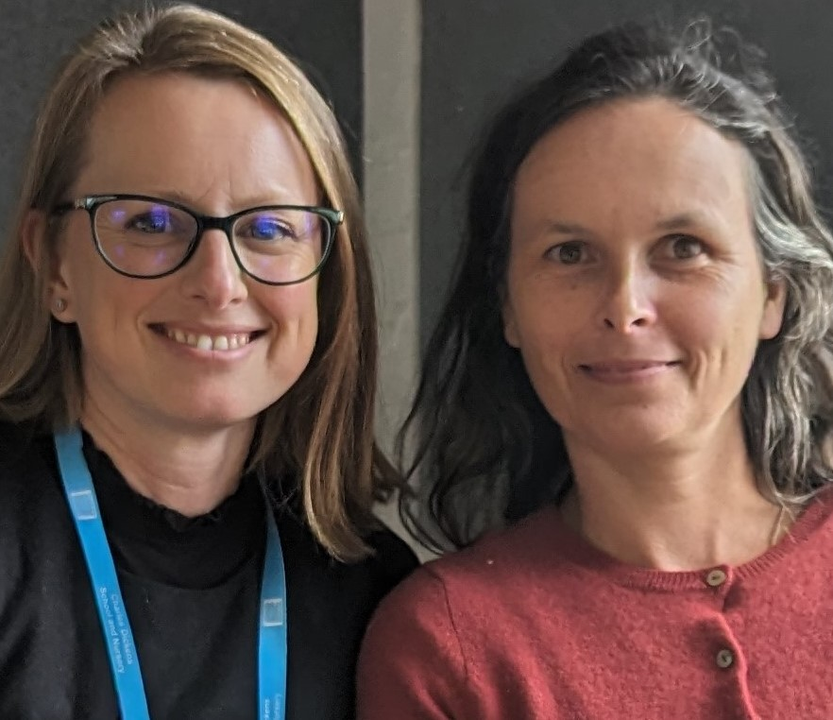
C&L example
Responding to our members needs
Overwhelming interest in support with Language development and SEND – Analysis of interest forms
Close working with our partners in Lambeth to make blog and webinar applicable to SEND learners.
We also involved all our partners to create resources to support the Early Stages of Communication and Language
Notes:
We at the London South Stronger Practice Hub first analysed the needs of our members. We then looked at the evidence to support the area of need, Communication and Language. Using the EEF toolkit we were able to identify the most effective practices supported by the most evidence. Looking at the evidence store we identified the 3 most recommended approaches or best bets for supporting communication and language development. We combined this with the practitioner knowledge of our partners especially when supporting children with SEND.
Following the blog we offered webinars to explain the 3 practices supported by evidence further. Always offering either a Saturday or evening for childminders to access and a usual CPD slot for nursery or school based settings.
Next we shared our practitioners' top tips for supporting communication and language taking account of the need to explicitly teach new vocabulary and language.

Slide 13
C&L example
Sharing the three most impactful approaches linking to evidence
Using the toolkit and the Evidence store
Teaching and Modelling Vocabulary
Teaching and Modelling Language
Interactive Reading
Blog, Webinar and Showcase linking approaches to practice including working with children with SEND.
Notes:
"Vocabulary instruction that explicitly draws pupils’ attention to words, their meanings and their features appears to be effective. Shared book reading has often been found to be a useful activity for this. Explicit vocabulary instruction may involve naming/labelling, discussing word meanings, providing synonyms, and analysing the sound and spelling features of a word. There is some evidence that it can be effective to combine explicit instruction with implicit teaching strategies, such as recasting and extending pupil’s statements." EEF evidence store
"Practices that may be effective can be either verbal or physical, and the evidence suggests that combining both kinds has the most impact. Verbal strategies include asking open questions about stories, prompting children to sequence stories, retelling stories, giving children corrective feedback, eliciting imitation, and relating stories to children's own experience. Physical strategies include story acting and using props and pictures."

Slide 14
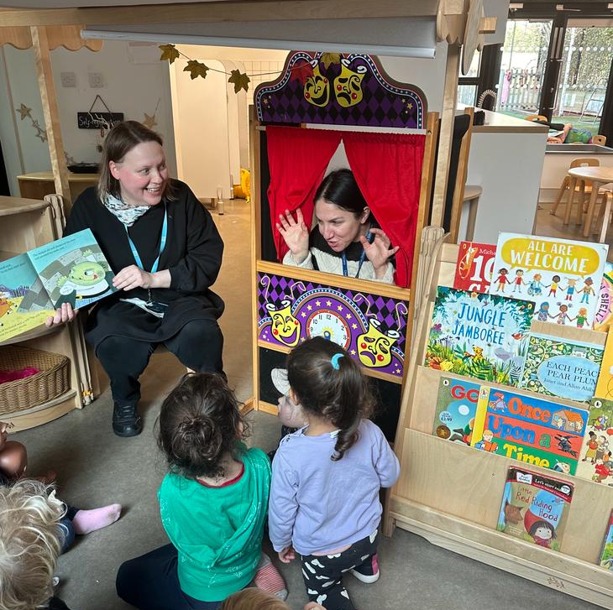
Interactive Reading
Practitioners welcomed viewing practice to learn how to implement the approach.
Future webinars have been designed to refine this approach
Focus on children commenting, speaking, rehearsing
Adults building on what children say
What does this look like outside
Notes:
During webinar training we used lots of images to exemplify these practices. This, and the use of videos was welcomed by participants who felt we really helped them see the research in practice. Making this connection between the research and the practice is how we become research informed.
We showed examples of commenting, speaking, rehearsing during typical moments in the day such as during lunch time, Continuous provision, group times and targeted interventions. This helped practitioners see clearly where they could implement the practices immediately.
We also touched on ensuring the same language learning principles and practices were used across the setting both inside and outside including on trips.
Practitioners themselves identified the common experience of acting out stories outside to be a form of interactive reading used as a powerful tool to rehearse language and refine speaking.

Slide 15
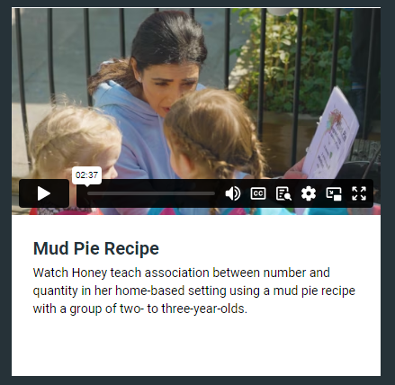
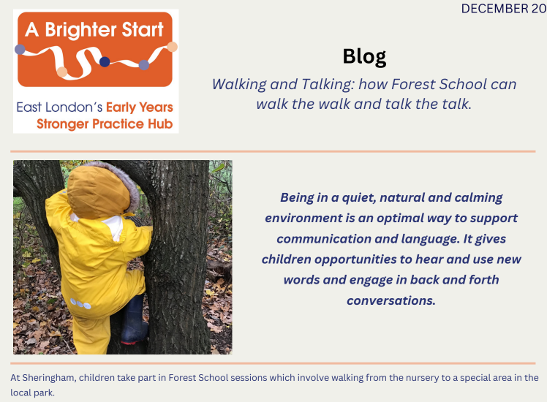
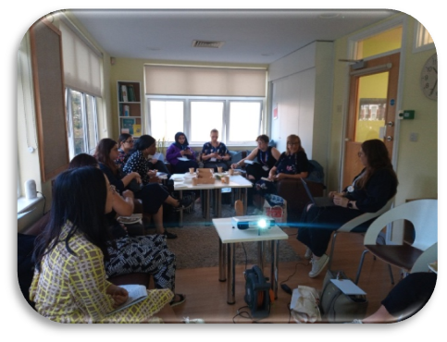
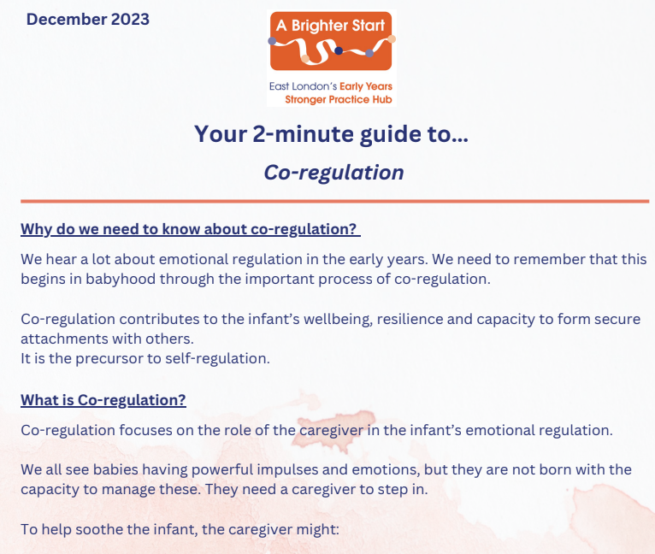
Bringing evidence-informed practice to life
Video exemplification
Blogs, case studies and articles written by early years professionals working daily in different parts of the sector
Showcases with an introduction to the evidence and then live exemplification of how that is translated into practice in our setting.
Notes:
At A Brighter Start our strategy for sharing what research evidence tell us are the bes bets has been about exeplifying evidence-informed practice. That place in the middle of the venn diagram that combines research evidence, with context and professional expertise and judgement.
Our aim is to make evidence-informed practice relatable and actionable, allowing practitioners to see themselves reflected in our work and able to image themselves having a go.
We do this in 3 ways:
Video – used in the evidence store, but also in webinars and our more in-depth training programmes. Video exemplification is a crucial vehicle for sharing evidence-informed practice.
Written content – based of research evidence taken from the evidence store, EEF guidance reports and the EY materials produced to compliment them. Also exemplify statutory and DfE produced documents like 'progress check aged 2'
Showcases – give an intro to evidence-informed practice, what the evidence says about an area in the evidence store, mainly focused on CL as that is what settings in our region are asking for. Then go into nursery to see it in action. Followed by a Q&A and signposting to next steps, and support with sustained PD. To do this we have to ensure that we practice what we preach – this requires sustained PD for our own staff team, being a RS has been hugely beneficial in this process. We have also created a model that supports childminder networks to see evidence-informed practice brought to life – during stay and play network meetings, one member of the team models practice with the childminder children, while the other narrates and spotlights the strategies being used. Equity across the sector

Slide 16
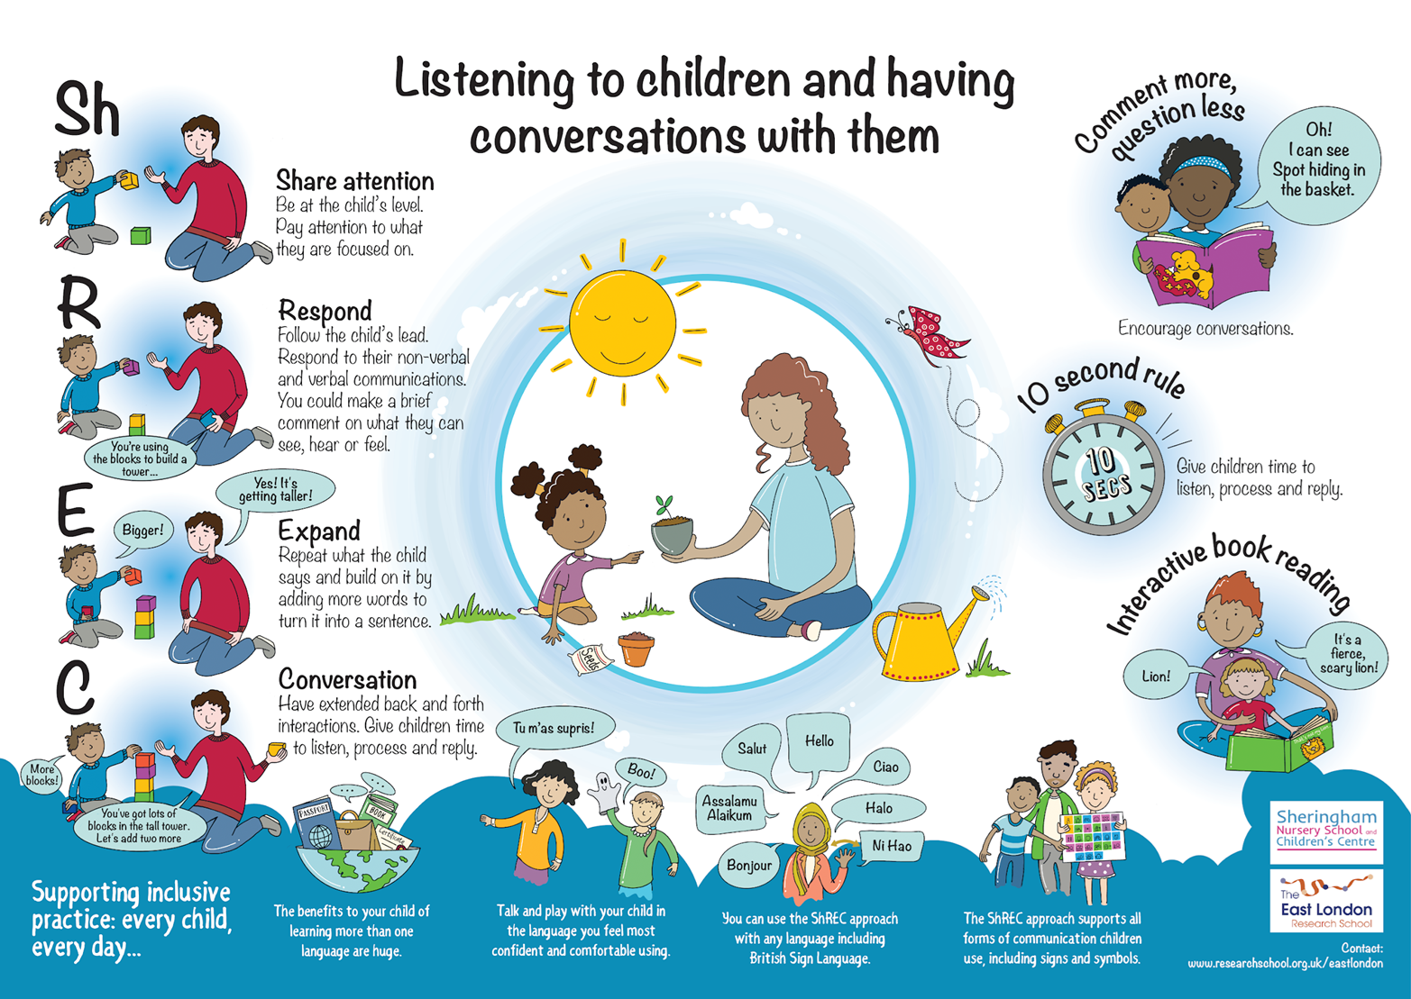
In-depth use of evidence
We have been developing evidence-informed practice and professional development to support communication and language since 2018
Manor Park Talks - Newham Communication Project – Early Years Conversation Project
This has allowed us to create exemplification, training and printable resources to support the sector.
The SPH programme has funded a large efficacy trial of our CL project and provided high-quality free training to 112 settings in London.
Notes:
Research evidence from the EEFs GR but also our own pilot funded by the EEF (MPTs) - had an effective strategies review at the same time (UCL:IOE). Using GR on implementation and PD to inform training design.
The work and learning from these iterative processes has allowed us to create exemplification for supporting CL in the form of blogs, videos and articles. It has allowed us to train our own staff team, our local network of PVIs in Manor park and then wider in the LB of Newham. This has created a community of practice and practitioners who can confidently use the strategies and reflect on their use with colleagues.
Contributing to the evidence store (us and partner childminders)
Our sustained PD programmes have allowed us to create spin-off webinars and resources for the SPH
We are also delivering EYCP to 112 settings in London. Being independently evaluated to look at the impact of the PD on practitioners pedagogy and confidence and children's outcomes. Contributing to the evidence base around what works for 2 year olds. Made possible by the SPH programme.

Slide 17
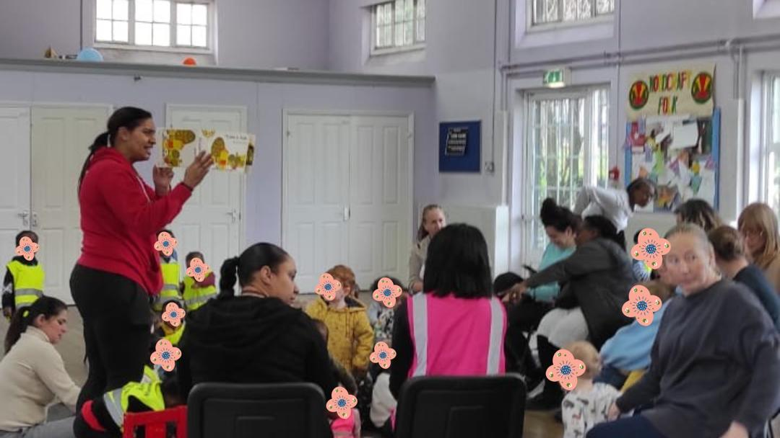
Impact
Notes:
"Thank you so much it was very interesting and lots of information I can use and apply in my setting."
Practitioners are really happy to have had us make the link between the research and the practice so they can pick up some of the practical advise and implement ideas immediately. Another positive aspect has been the peer learning and sharing of practice between participants. We have also been fortunate to witness one of our lead childminders putting into practice ideas from the training she had attended on interactive reading. Reassuring some practitioners that lots of what they are doing is backed by research. We have found settings really happy to develop the ability to articulate why what they do matters, why they have chosen to read certain books and really think about the explicit language and vocabular they want their learners to use.

Slide 18
Impact
"Lots of CPD webinars to attend to influence practice"
Richard Gibson, Holden Lane Primary School
The training opportunities for upskilling knowledge within practice"
Leighann Dulledge, Kangaroo Pouch - Harden
Thrive Together has offered a lot of information that haven’t been provided elsewhere. More available courses with resources and a support group for any questions needed
Helping Hands Childminding
"My practitioners really enjoyed the SMILE training and the two professional development webinars they have attended so far, it’s refreshed knowledge and given them their spark back".
Rebecca Ralph, Early Milestones Nursery
Prior to Number Sense some staff were struggling with maths concepts such as subitising, since having seen the model session and being coached they are now implementing concepts confidently in their daily practice.
Asma Zaki - Abu Bakr Day Nursery
“This has been the best recovery programme I have been involved with because it leads to measurable improved outcomes for Walsall (and other) children and improved professionalism in the workforce”
Nicola Hart,Walsall LA .
“The team have networked with our EY leaders and there has been an enthusiastic response...The CPD via SPH matches the needs that all professionals are seeing impact their settings."
Emma Drakeford, Stoke-on-Trent LA

Slide 19
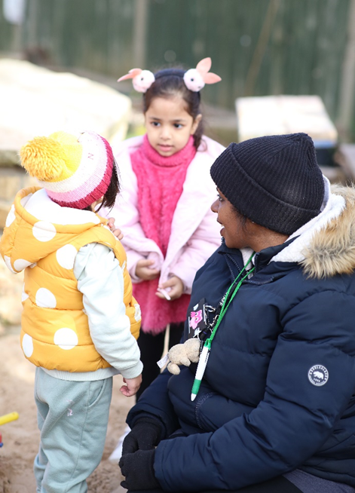
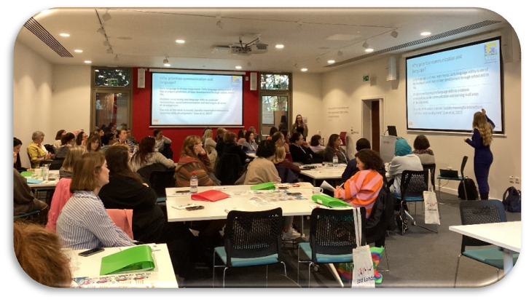
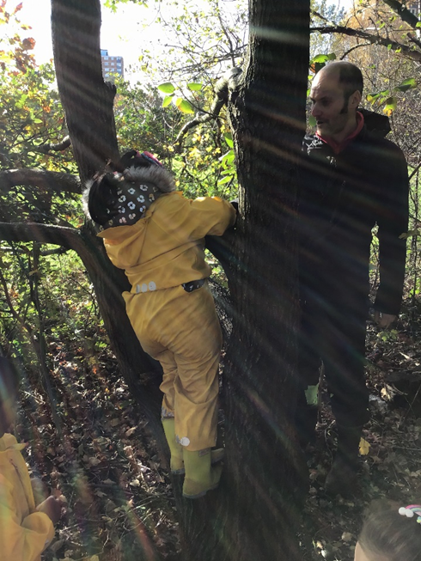
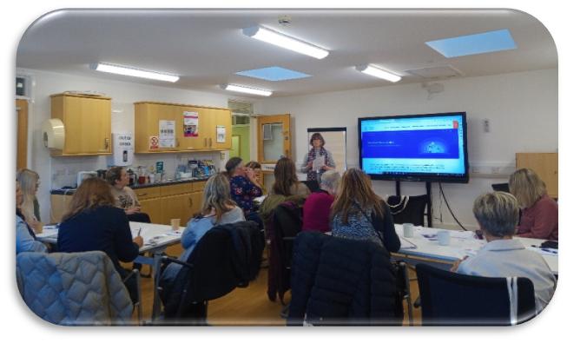
What aspect of training did you find most useful?
"All of it!"
"The explanation of the clear links between research, how it looks in practice and how it can be embedded"
"Loved the networking and meeting new people"
"Practical examples of techniques in action"
"I find the videos most helpful"
"Videos are the most effective, real-life example of good practice"

Slide 20
Future possibilities...
Continue to bridge the gap between evidenced based research and local practice.
Sustain communities of practices, to embed evidence-based practices.
Continue to unite the sector and break down barriers.
Support new EY expansion offer

Slide 21
Contact
n.davies@ryders-hayes.co.uk
EastofEnglandSPH@highfield.suffolk.sch.uk
eysph@londonsouthtsh.org
abrighterstart@sheringham-nur.newham.sch.uk

