Slide 1
Establishing and maintaining effective partnerships that make the Hub most impactful
Notes:
Bristol and Beyond

Slide 2
WHO are our Key Partners?
National Partners such as the DfE/EEF/NCB
Regional Partners such as the English Hub, Maths Hub, Family Hub, Teaching School Hub, SCITT, other Stronger Practice Hubs
Research schools and specialist provision schools
Area Leads for Experts and Mentors, both PVI and Childminder, SLE’s and NLE’s
Our own localised Partners including the range of nursery settings and childminders identified as delivering high quality evidence informed practice within local areas
Local Authorities and Combined Authorities
Teaching School Alliances
Universities
Plus other key providers to the early years sector such as Elklan, EYPDP, Best Practice, Pacey, Dingley’s Promise, Hartbeeps, Helicopter Stories etc.
Notes:
Presented by Liverpool and Beyond
Stronger Practice Hubs have a number of Key Partners, some of which are national partners such as the DfE, EEF and NCB, others are regional partners such as English Hub, Maths Hub, Research Schools and other partners are more localised to each individual Stronger Practice Hub. This opportunity to engage with a range of Key Partners has enabled the Stronger Practice Hubs to build on existing partnerships. This in turn has brought to the fore opportunities to acknowledge and deliver high quality evidence informed practice with colleagues.

Slide 3
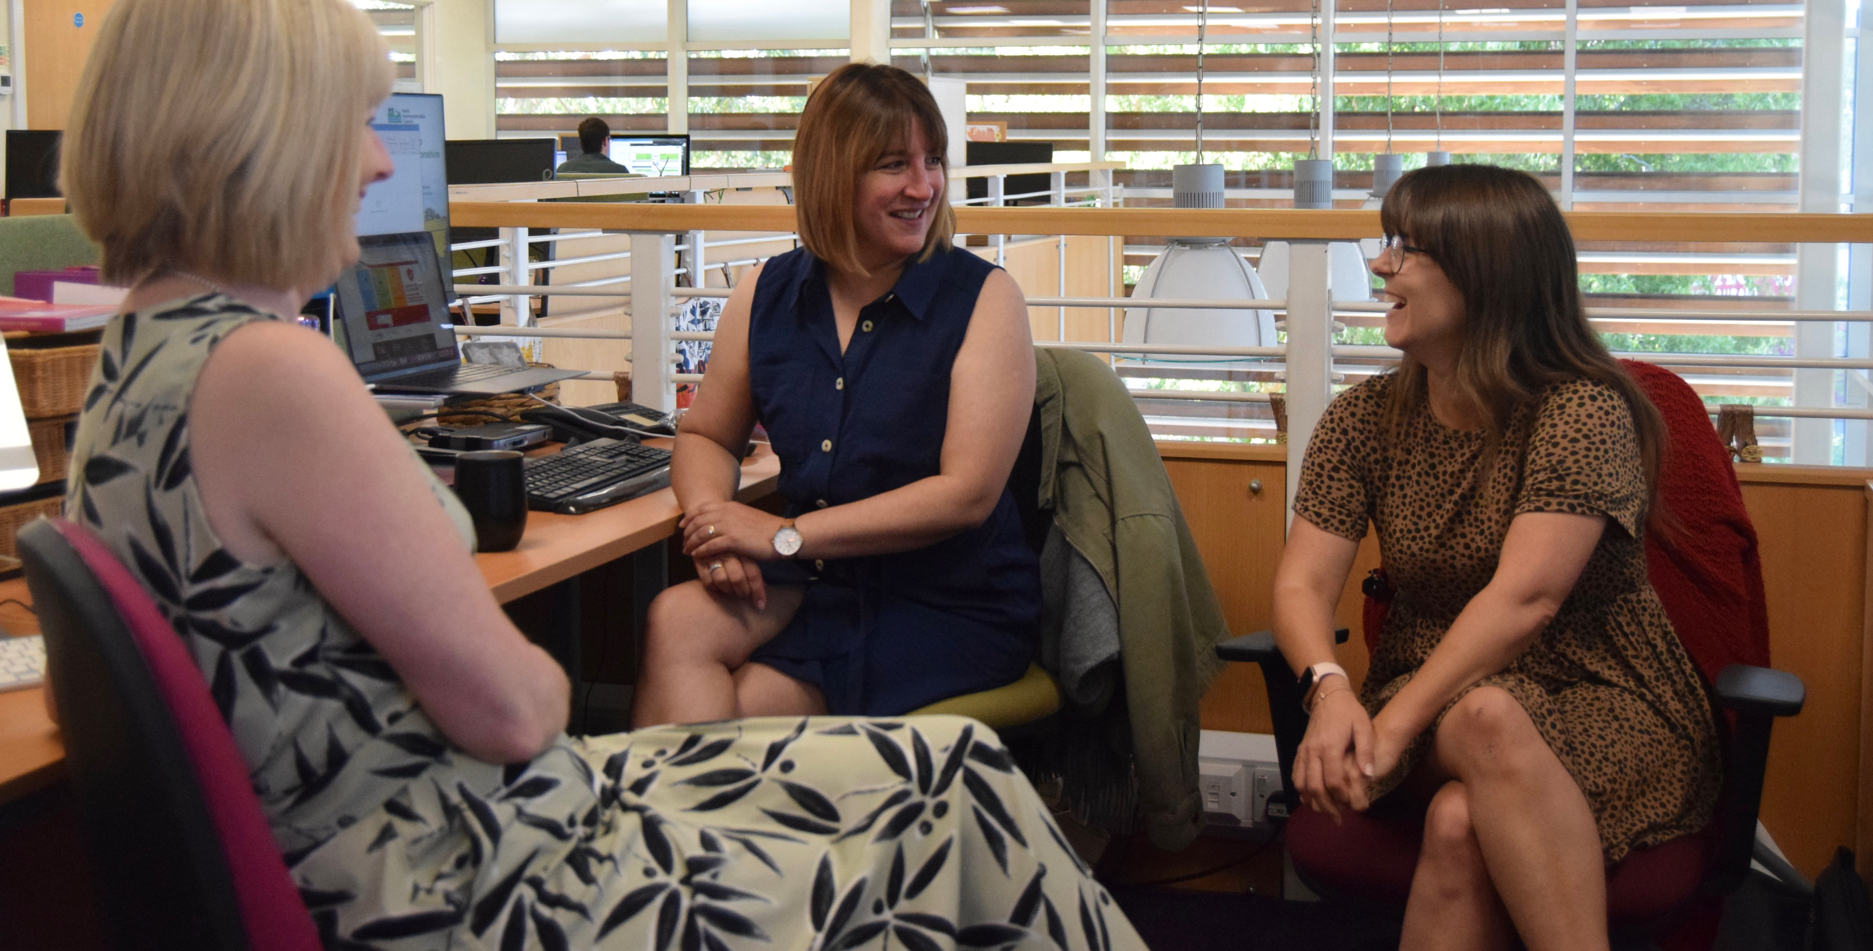
HOW did we get them on board?
Email introductions and SPH launches to breadth of sector
Use existing connections and networks
Face to face & virtual meetings tailored to each partner
Identifying expertise and strengths, identifying gaps in local offer aligning delivery with local need
Invitation to contribute to hub offer – collaborative working through events, blogs, case studies, mutual sign-posting
Termly/half termly wider partners/LA meetings – to include info sharing about bespoke PD and network offer
Attendance at LA strategic meeting, networks and conferences
Working with key advisors with specific expertise e.g. childminder, PVI’s and nursery development leads
Using a range of social media and SPH website to engage the range of different providers to sign post and promote the SPH, DfE & EEF funded offers / showcase examples of best evidence informed practice
Persisting, listening, consulting, accommodating, involving, contributing, delivering
Notes:
Bright Futures
As per slide text
Initial meetings about listening to partners needs, context and talking about how we can complement this
Identifying their strengths and not duplicating local offer
Encouraging collaboration taping into local knowledge and skills and best practice
Revisiting partnerships regularly
Getting involved and supporting partners work
Importance of the Mentor scheme in developing CM partnerships
Supporting promotion of events

Slide 4
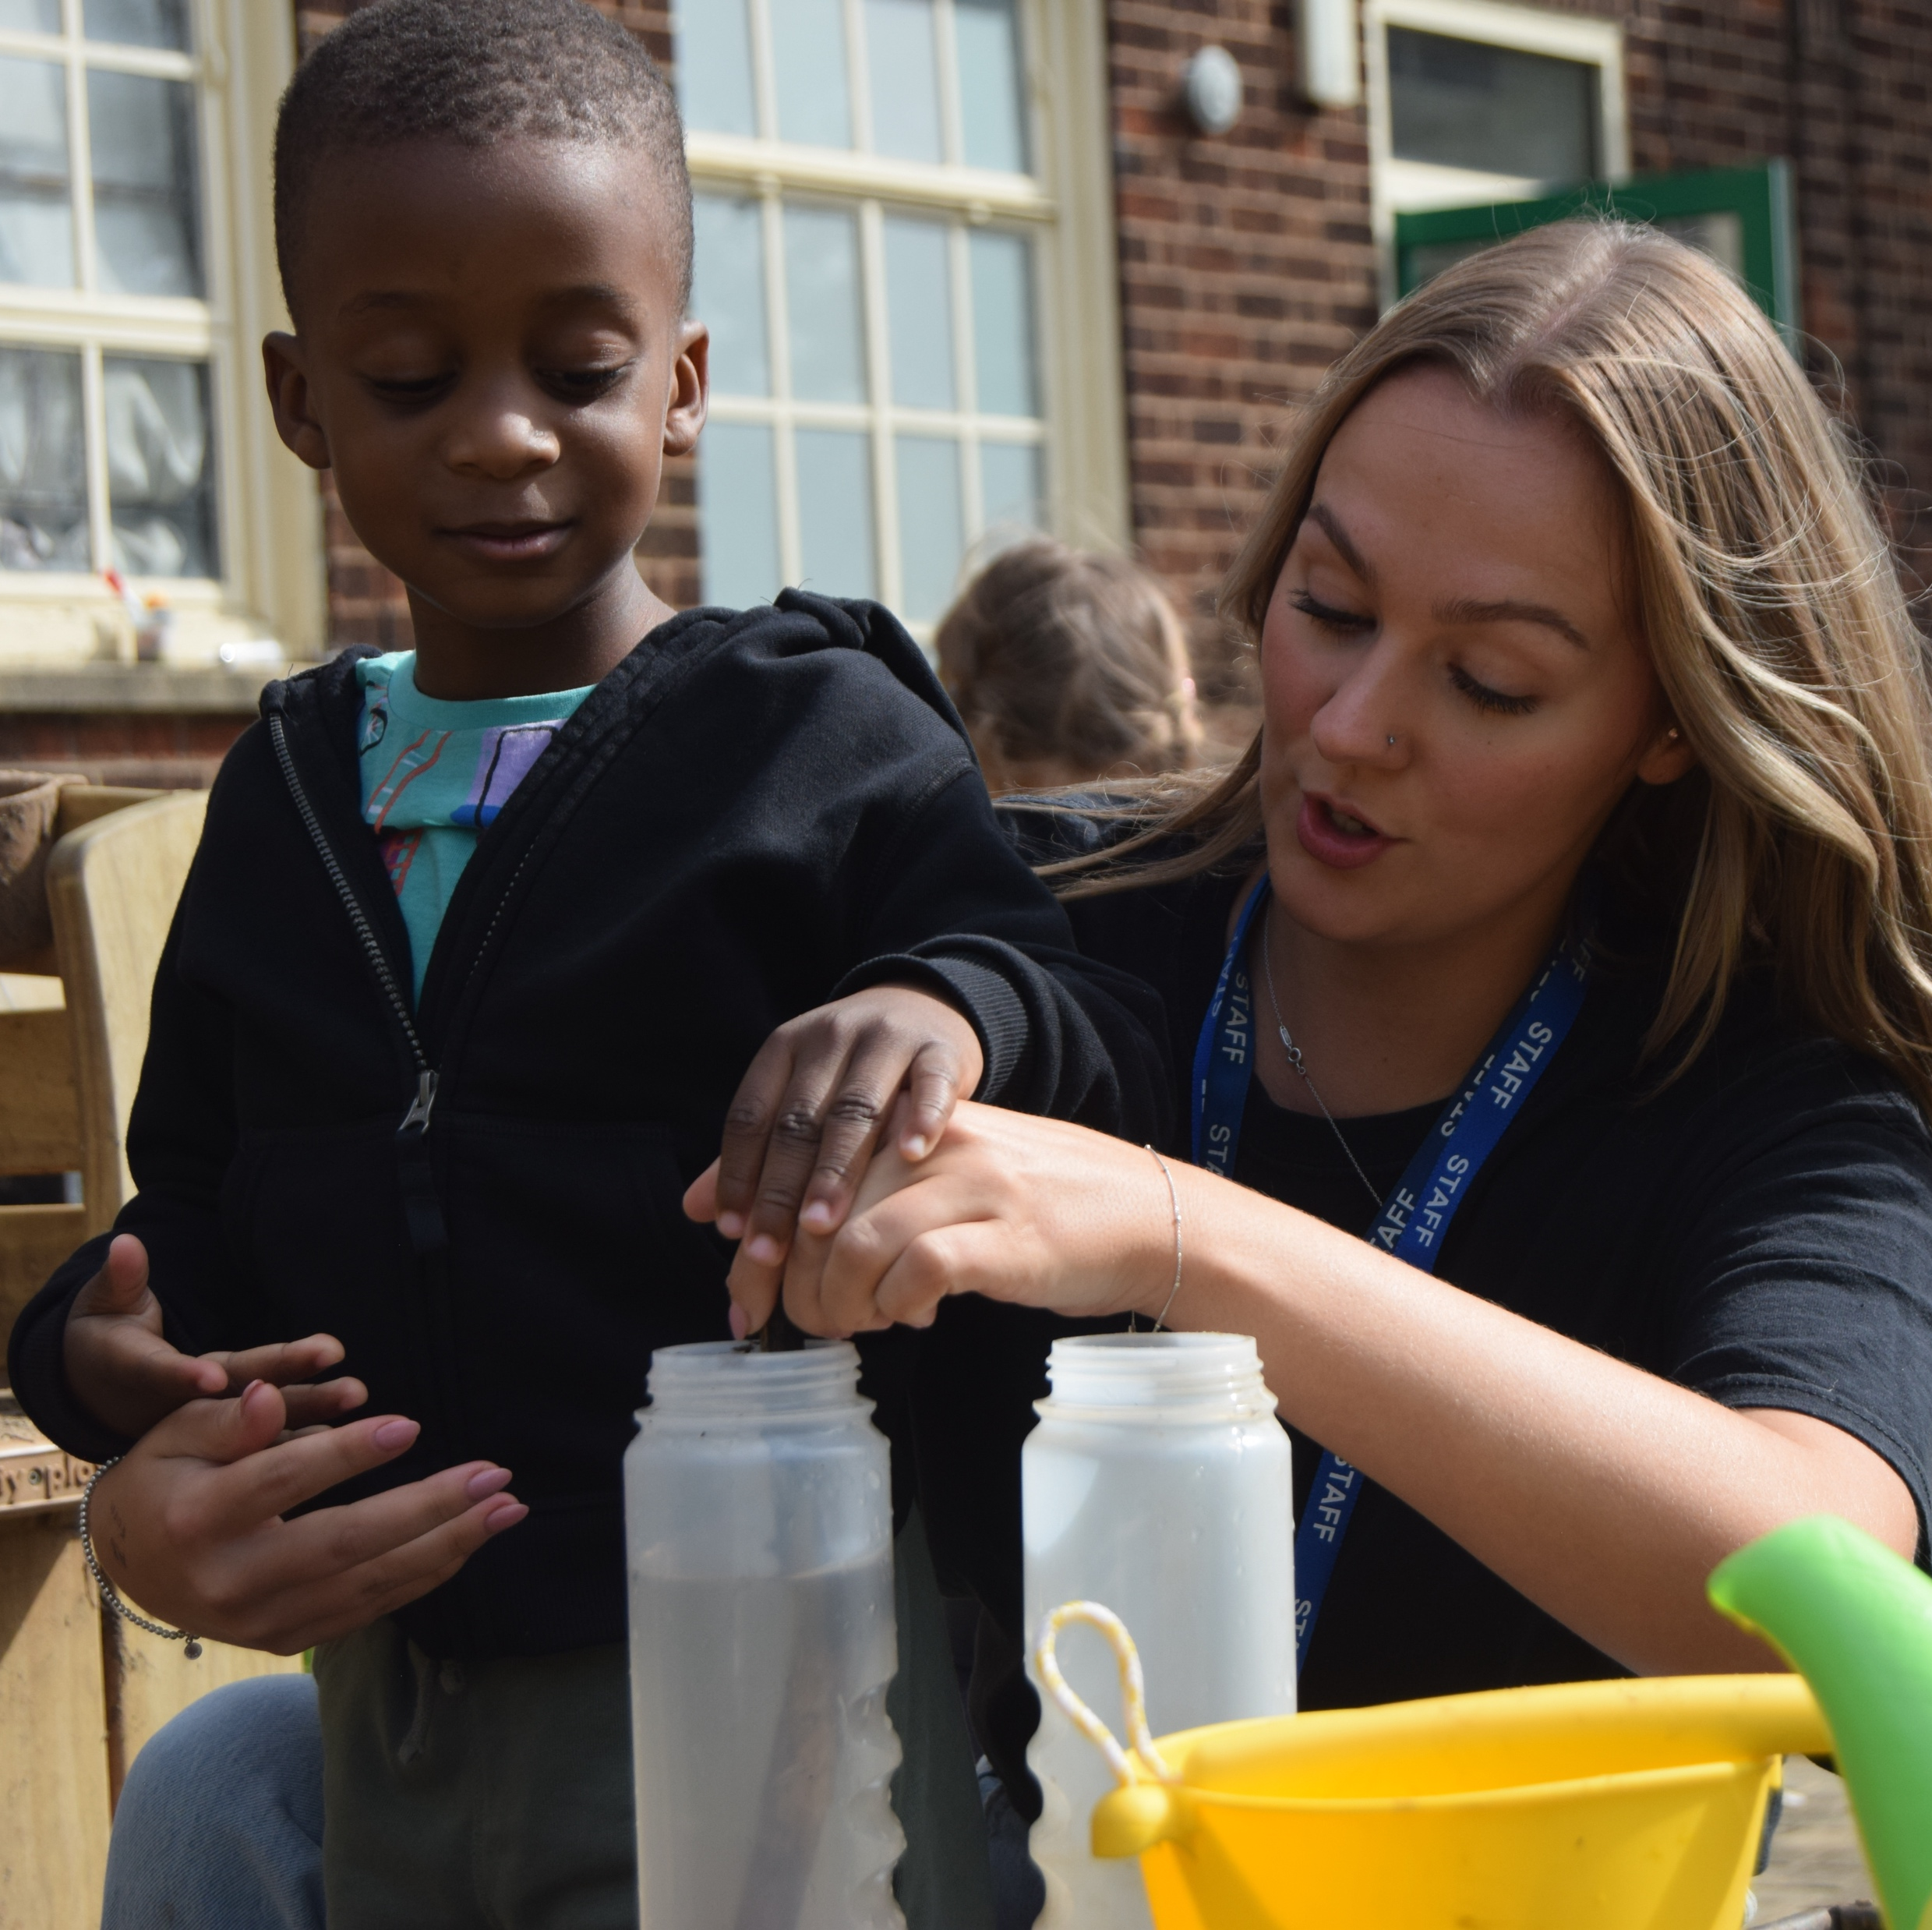
WHAT sort of things are we working on with them?
Sustaining and building and re-establishing networks where need exists
Using existing networks to disseminate evidence based best practice and bring expertise
Delivering bespoke support and CPD responding to needs identified by local data and needs assessments
Roadshows, learning walks, face to face training
Targeting settings in areas of disadvantage
Sharing data and intelligence
Sign posting to national offers and wider recovery programme e.g. Childminder Mentor scheme, NPQEYL, EY SENDCO training
Blog writing, produce resources, present at and facilitate co-host other event, develop webinars
Partners help promote our activities increasing engagement
Sustainable legacy.
Raising profile of the EEF Evidence Store materials
Using social media to increase numbers of engagement from all provider types
Working in partnership with Research schools to showcase evidence informed practice
Ongoing - response to audits and feedback from the sector informs future PD programme content and support
Notes:
Bright Futures
As per slide text above

Slide 5
IMPACT of this to date?
Hub reach is growing daily evidenced through mailing lists, social media, websites and phonelines bringing offer to increasing numbers of childminders and EY practitioners
Leading to well attended networks and events increasing access to high quality evidence-based programmes and training
Giving a voice to the sector - practitioners and childminders are providing feedback related specifically to their areas of need
Delivering packages of support for all provider types
Increasing childminder engagement with Hub, they are feeling valued leading to childminders sharing SPH information widely with their colleagues
EY Practitioners have raised awareness of the Evidence Store and best practice
Partnerships are also raising the profile of evidence informed practice
Very positive relationships with the EYFS Leads from LAs enabling a targeted approach and a greater level of depth. Local offer - bespoke to local needs
Hubs facilitating LAs working together on common need
More equitable offer to the EY sector across all LAs
Growing and developing an effective infrastructure of partnerships, consisting of a range of EY stakeholders
Hubs receiving an increase in offers from a range of EY professionals to collaboratively support the sector
Collaborative working to upskill the EY workforce through raising awareness, modelling and supporting implementation of evidence-based practices in settings
Where the relationships with partners are strongest recruitment to the EEF programmes are increased
Notes:
With Covid still very prevalent, a cost of living crisis and the recruitment and retention crisis very much an issue we wanted to share the impact of our partnerships…..

Slide 6
Liverpool City Region and Beyond Early Years Stronger Practice Hub
www.evertonnurseryschoolandfamilycentre.org/strongerpracticehub
The Great North Early Years Stronger Practice Hub
https://www.strongerpracticehubs.org.uk/hubs/ne/great-n-eysph
East Midlands Early Years Stronger Practice Hub
https://www.pengreen.org/stronger-practice-hub/
Bristol and Beyond Stronger Practice Hub
https://beyth.co.uk/sph/
Bright Futures NW Early Years Stronger Practice Hub
https://earlyyears.bright-futures.co.uk/
Notes:
With Covid still very prevalent, a cost of living crisis and the recruitment and retention crisis very much an issue we wanted to share the impact of our partnerships…..

