Slide 1
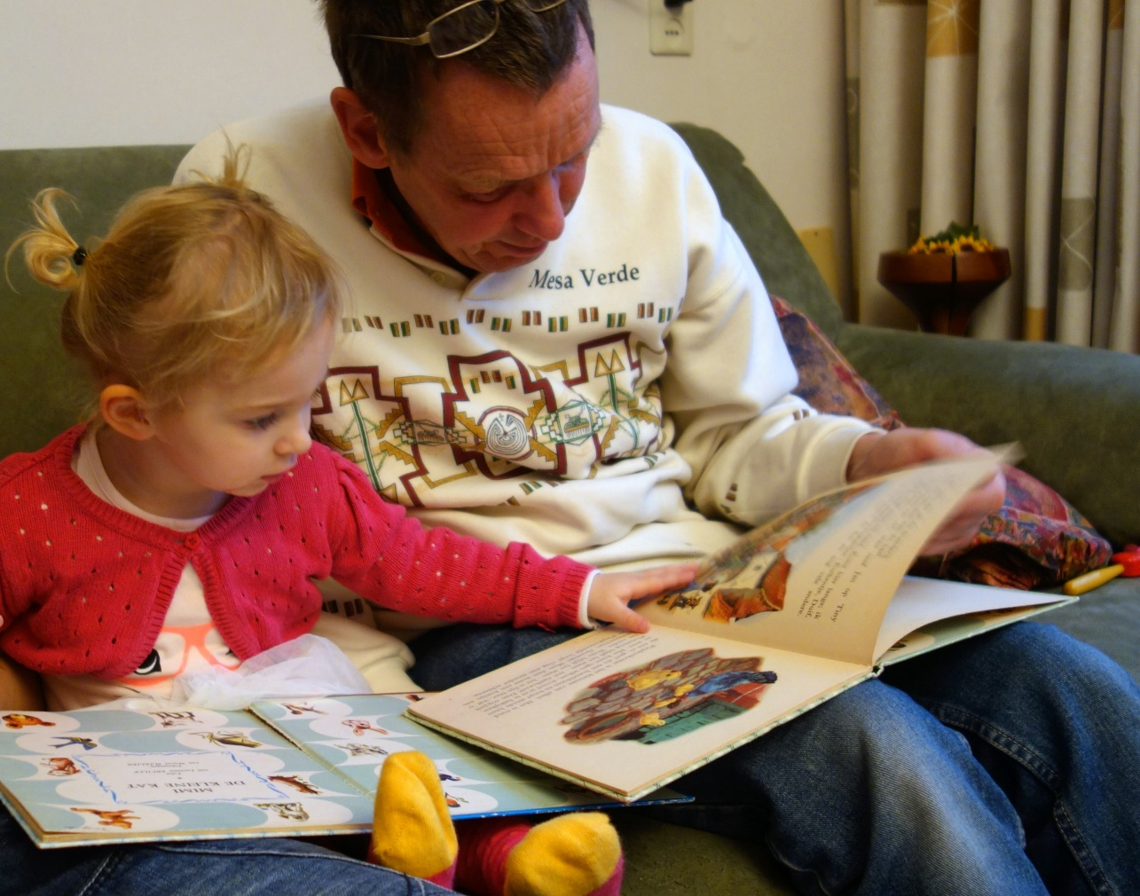
Communication and Language
Supporting the Early Years Sector
Notes:
Mary 11.00-01 Notes
Welcome
Introduce self & hub
Introduction of which Hubs are present:
Sian Hudson from St Edmunds, Yorkshire and The Humber
Emma Whelam-Tate from Northern Lights
Lucie Hulbert – Early Years South West Stronger Practice Hub
Explain the titles of the session

Slide 2
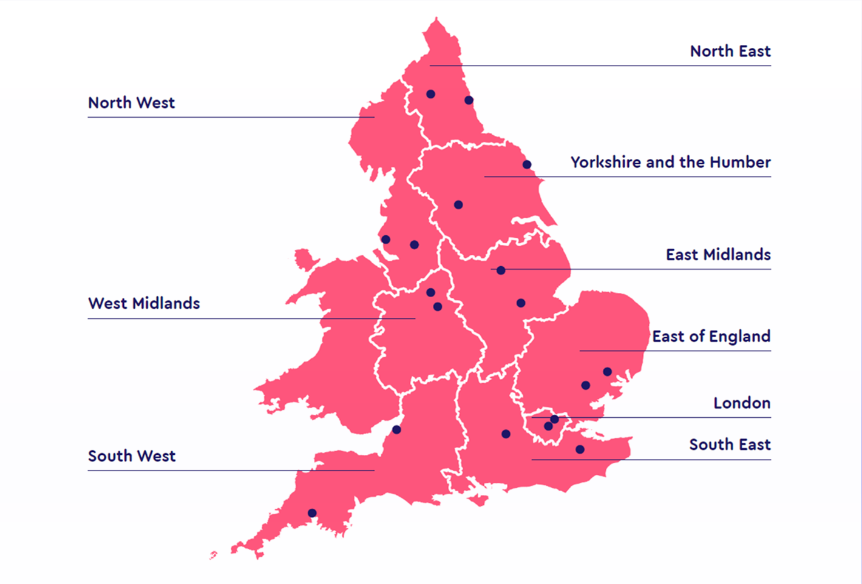
Notes:
Mary 11.01-02 Notes
Introduce the location of each of the Hubs and the spread across the country

Slide 3
Where we began….
Notes:
Mary 11.02-03 Notes
Explain that the session will be like a ‘journey’ through our delivery on communication and language so far and will include where we began, the road we’ve travelled so far and where we’re heading next.

Slide 4
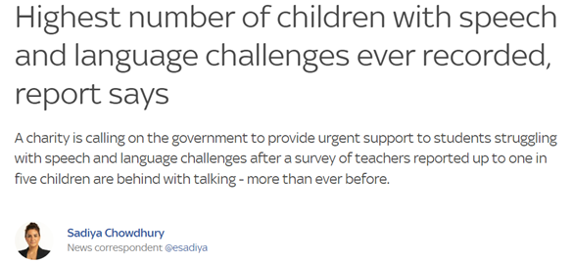
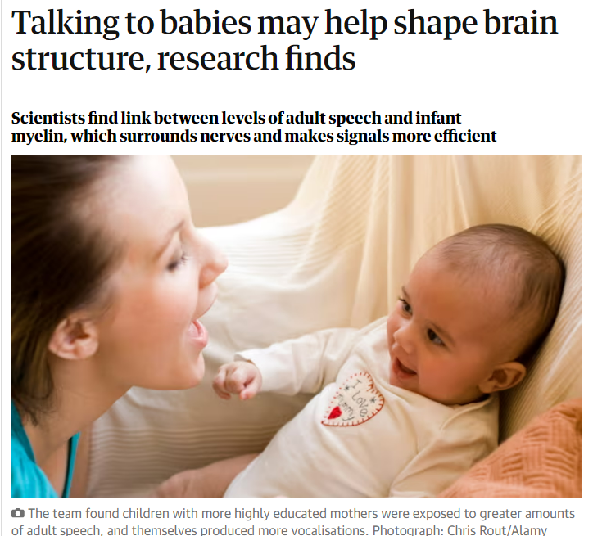
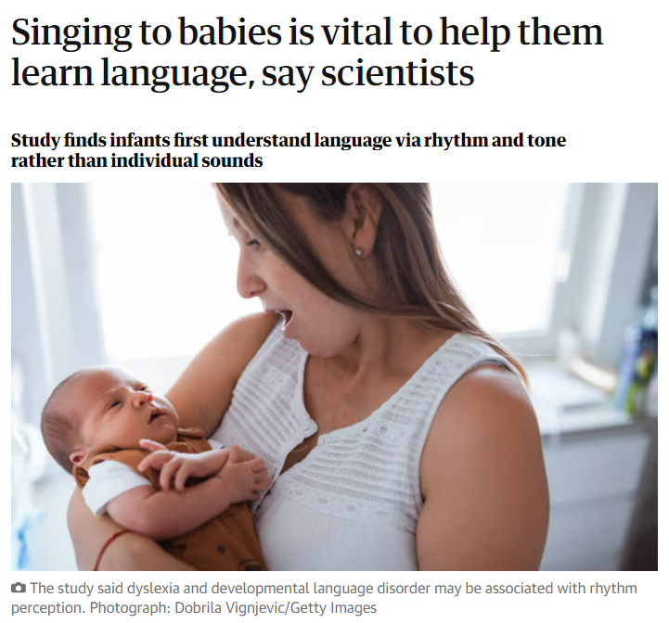
C&L in the headlines
Notes:
Mary 11.03-05 Notes
Discuss the summary of some of the news on communication and language, the impact of the importance of having quality strategies in place for supporting communication and language in the early years and the demographics currently and challenges for settings.

Slide 5
What is the National Picture?
NHS and independent sector are overwhelmed with demand for speech and language therapists.¹ The wait time to see a speech and language therapist in our local areas is 18-24 months.
National shortage of S&L therapists - recent survey by the RCSLT of vacancies in the profession found an average vacancy rate of 25% in children’s speech and language therapy services in England. ¹
EEF EY Toolkit recognises C&L approaches as having the most impact (+7 months), for the least cost (£), with a reasonably secure evidence base ( ).
OFSTED – renewed focus on early language recognises importance.
¹ Fail to plan, plan to fail: speech and language therapy workforce planning in England (April 2023, Royal College of Speech and Language Therapists and Association of S&LTs in independent practice)
Notes:
Lucie 11.05-07
¹ Fail to plan, plan to fail: speech and language therapy workforce planning in England (April 2023, Royal College of Speech and Language Therapists and Association of S&LTs in independent practice)
https://www.rcslt.org/wp-content/uploads/2023/04/Workforce-planning-in-England.pdf
Notes
Read through slides

Slide 6
Evidence about impact on life chances
Language at age 5 is the single most important factor in influencing literacy levels at age 11.
Poor language at age 5 means you are four times more likely to struggle with reading at age 11.
Children struggling with language development at 5 are:
six times less likely to reach expected level in English at age 11, and
eleven times less likely to achieve the expected level in Maths.
Early language skills at five are linked with employment outcomes at age 34.
Good language skills at 7 predict better quality friendships at age 16 (Durkin & Conti-Ramsden, 2007)
Information from Speech and Language UK
Notes:
Lucie 11.07-09
First four points are from Speech and Language UK materials
Notes
Read from slides

Slide 7
Meeting the needs of our localities in The South West EY SPH
Feedback from launch event and subsequent evaluations
90% of calls and contact for support is language and communication based
Practitioners required practical and immediate ideas for interventions as well as theory
A range of delivery methods required in order to meet the needs of the area covered.
Communication & language is embedded through everything we offer as a Hub.
Notes:
Sian 11.09-10 Notes
Discuss how the South West gathered feedback so far
Read from slides

Slide 8
Meeting the needs of our localities in The North East of England EY SPH
Needs analysis across 10 LA's identified CL in top 3 priorities (CL, PSED & SEN) with our home area identifying CL as top priority across all areas of the EY workforce
Practitioners requested support around 'upskilling' in comparison to intervention programmes to establish a 'best practice' model for their settings
84% of practitioners requested face to face events
100% of hub output includes CL
Notes:
Sian 11.10-11 Notes
Discuss how the North East gathered feedback so far
Read from slides

Slide 9
Meeting the needs of our localities in The Derbyshire & Nottinghamshire EY SPH
Needs analysis across four local authorities identified Communication and Language Development as a key area of increasing need.
Feedback from settings registered with the SPH identifies C&L development as an area where they would most like support.
Focus has been on upskilling whole workforce and improving universal provision for all children, alongside specific interventions for some children.
Specific challenges where there are high levels of EAL in the workforce.
Notes:
Sian 11.11-12 Notes
Discuss how Derbyshire & Nottinghamshire gathered feedback so far
Read from slides

Slide 10
Meeting the needs of our localities in The St Edmund’s EY SPH Yorkshire & The Humber
Ongoing 'Development Needs Analysis' identifies C&L as the highest priority for support across our reach area
Our Communication & Language webinar was by far the highest attended event across all our hub activity to date
Whilst face to face events were originally requested across the sector in our locality, in reality it has proved too difficult for settings/EYs educators to attend in high numbers. Online is easier.
C&L is embedded within the work of all our 'Specialist Learning Networks'
Communication & Regulation, SEND, Childminding, Outdoor Play & Learning, Leaders & Emerging Leaders
Notes:
Sian 11.12-13 Notes
Discuss how St Edmund’s, EY SPH and Yorkshire & The Humber have gathered feedback so far
Read from slides

Slide 11
The road we’ve travelled…
Notes:
Emma 11.13 Notes
The road we have travelled so far

Slide 12
Partners and Stakeholders
Notes:
Emma 11.13-14 Notes
The Hubs have all made excellent connections with stakeholders and largely part of the success of the Hubs has been due to the excellent collaborative work with:
Nurseries
LAs
Childminders
Schools
Leaders
Mentors
Etc
Effectively using the expertise of many professionals and bringing those themes together to product excellent work.

Slide 13
Overcoming Challenges
Being flexible and adaptable to meet the needs of the workforce:
Staffing crisis
Capacity challenges
Choice of delivery model
Meeting needs across a wide geographical area with a small team
Working to a tight timeframe and detailed specification
Notes:
Emma 11.14-16 Notes
Common challenges across all Hubs
Read slides

Slide 14
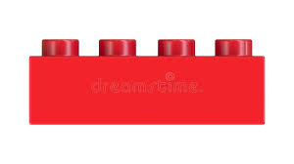
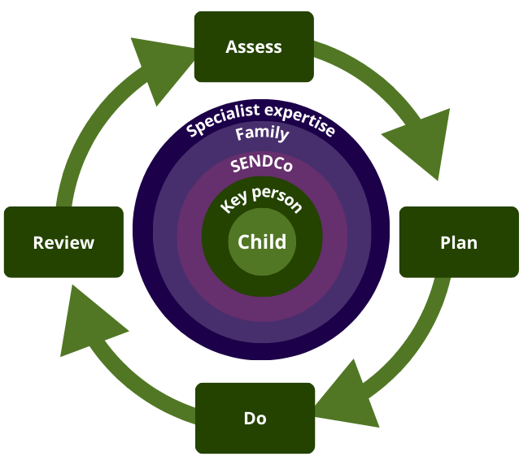
A Graduated Approach and High-quality Teaching Models
Specialist Teaching
External SEN support
Targeted Teaching
Differentiated support
High-quality Teaching
For all children, not just those with SEN
Notes:
Mary 11.16-18 Notes
Discuss and explain graduated approach and it’s importance when considering our plans (link to identification of need to upskill whole team and improve universal provision across all hubs)

Slide 15
Work to be Celebrated (EEF Programmes)
"Elklan’s CFS (including home based for childminders) has a positive impact on both the staff and the children within your setting. The process begins with staff completing Elklan’s acclaimed 10-week course, Speech and Language Support (SLS). This course explores the complex subject of speech, language and communication development in children and young people and gives participants practical knowledge and skills to support children with speech, language and communication needs.“
“Using Talk Boost can significantly improve
children’s talking and understanding of words. Two thirds of children make good progress after just eight to ten weeks of the programme"
TWiTCH enables practitioners to develop practical strategies to help ALL children to build language and reasoning skills. Practitioners adopt how to use a clearly structured intervention that builds on familiar Early Years practice (Storytime and small group work) to improve the quality and quantity of adult-child interactions.
Notes:
Emma 11.18-20
Communication Friendly Settings & Communication Friendly Settings Home Based - “We are currently working through the Elklan programme and creating a communication friendly setting. Two children have been chosen as a focus for case studies. The strategies that have been implemented due to the programme have been shown to have a positive impact on these children. The children are showing more focus and their listening and attention skills are improving. The increased use of visuals has aided the children’s understanding and improved their behaviour. They are now able to follow instructions and are beginning to regulate their emotions.”
ETB - “One of the resources we have been able to access is Early Talk Boost. As money for training and resources is always tight it was great to have the SPH provide funding for this. The resources are very high quality, the manual is very clear and training really helped to explain how this works. I am now using this programme for the second time after trialling it before the summer and I am really impressed with the progress our children did/are making with this intervention. We are coming to the end of the intervention for the present group of children and will be working with another group of children in the new year. Feedback from both the children and their parents has been very positive. It is lovely when parents have told us how much the children enjoy listening to the Tizzy books at home and the children talk about them during their sessions, so I know they are enjoying the stories.”

Slide 16
Spotlight on Early Talk Boost (NL)
Early Talk Boost - Year 1- 30 places - Year 2- 30 places, Total: 60 places
Two-year S&L UK project has successfully trained 30 settings in its first year, with an additional 30 settings currently undergoing Early Talk Boost training.
Engaged with over 120 early years practitioners, positively impacting hundreds of early years children facing challenges with talking and understand words, along with their families.
Proactive, supportive and responsive, meeting established targets and promptly address challenges in relation to SL&C.
Notes:
Emma 11.20-22 See previous slides

Slide 17
Feedback & Impact
Feedback from both the children and their parents has been very positive…”the children enjoy listening to the Tizzy books at home and the children talk about them during their sessions, so I know they are enjoying the stories.”
Feedback from settings has been positive: “I am now using this programme for the second time after trialling it before the summer and I am really impressed with the progress our children did/are making with this intervention. We are coming to the end of the intervention for the present group of children and will be working with another group of children in the new year.”
Notes:
Emma 11.22-23 Notes
Share feedback and impact quotes from a range of stakeholders

Slide 18
Work to be Celebrated (Workshops and Networks)
Communication & Language networks/workshops for practitioners (SW & St Ed)
Bespoke SaLT support for settings (SW)
Drawing Club – promoting language and communication (SW)
Rachel Mortlock Workshop Series – F2F and online CPD sessions focussed on practical approaches to supporting C&L (DN)
Notes:
Lucie 11.23-25 Notes
Explain each of bullet points
Read rest of slides

Slide 19
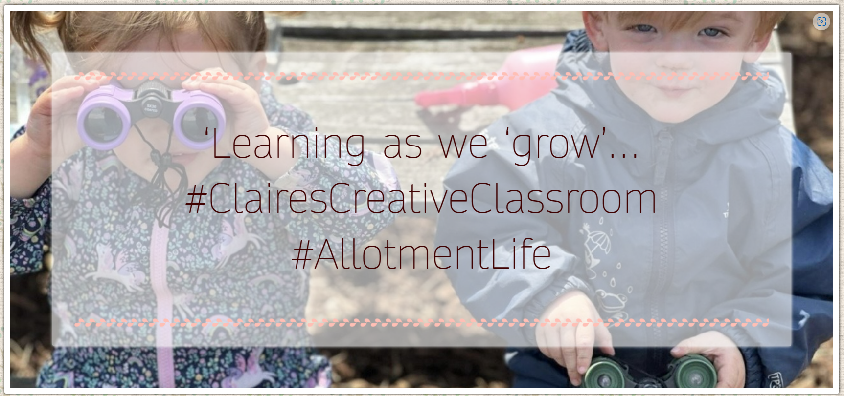
Work to be Celebrated (Resources)
Learning as we grow… Blog (NL)
Because Development Really Does Matter Blog (NL)
BECERA Blog on action-based research (NL)
Effective Interactions Webinar – using EEF (NL)
C&L Webinar with Keena Cummins BB-19 website (St Ed)
Open days, blogs, case studies & webinars – focus on supporting social communication in a range of settings (DN / St Ed)
‘It’s a bit like’ on our Youtube channel – short videos focused on language and communication development (SW)
‘Diamond Nuggets’ on our Youtube channel – short videos focused on modelling strategies and aids to support communication (DN)
Notes:
Emma 11.25-27 – (Mary to play video of diamond nuggets next if there is time) Notes
Read from slides
Show first 2 links

Slide 20
Notes:
Mary 11.27-31 Notes
Optional video if time (DN Diamond Nugget) – 3.5 mins – could just show two snippets of sections (theory and practice)

Slide 21
Work to be Celebrated (Childminders)
Communication-friendly Settings - Home Based EEF Programme (NL)
TWITCH for Childminders (St Ed)
Tiny Tweeties (NL)
Nature Pioneers (NL)
Monthly Network Events (SW, St Ed)
Weekly communication and language workshops - 2 hours per week over 7 weeks (SW)
Touring childminder network events (DN, St Ed)
Webinars and Case studies (DN)
Childminder Visitor Sessions (St Ed)
Notes:
Sian 11.31-33 Notes
Hubs recognise the importance of supporting childminders.
Emma to explain what CFS (Home Based) is and how it benefits childminders
Sian to explain what Twitch for childminders is and how it benefits childminders
Emma to explain Tiny Tweeties and Nature Pioneers
Read the rest

Slide 22
Our Impact
It is really informative and appropriate training. It would be good to be able to enable other early years providers to experience it too. (SW)
I think the hub is an invaluable resource for us early years settings. Thank you for all of your hard work. (SW)
The workshops highlighted a lot of things we do already as practitioners but gave meaning and a new perspective to the real struggles children can have when learning to talk. I am very grateful to have been able to participate in this course. I have learnt so much and now have a greater understanding which will inevitably help me to support children and their developing speech and language. (SW)
All our staff really enjoyed the communication chain workshop and have all been able to adapt their practice to help ensure childrens understanding. (SW)
Notes:
Lucie 11.33-34 Notes
Feedback has been resoundingly positive.
Read 2 of the bubbles
Suggestions are captured and help each Hub to mould their future offer

Slide 23
The stronger practice hub has been instrumental in improving our practice and the outcomes for the children in our setting. The network events have been both informative and inspiring and a great way of meeting other professionals and providing opportunities to liaise and learn from one another. All of the CPD has been free and of the most amazing quality and opened a lot of opportunities for our settings. (NL)
You have not only supported me in the way we view learning with the children but have given us the tools to enhance our pedagogy using evidence-based practice. (NL)
I absolutely loved every second of this session. Using this approach is going to make so much difference to my children. It’s been a reminder of the importance of reading, signing and interacting with children and has reignited my passion which has been lost for a while. (NL)
Everything about this session was perfect! You don’t always get the right mix of theory and evidence and how to do it in the setting. (NL)
Notes:
Lucie 11.34-35 Notes
Read feedback

Slide 24
Where are we heading next?
Notes:
Mary 11.35-36
Recap where we’ve come from (15 months ago), all the work that has been done to date, what is planned for the next 7 months, and thinking about how to create a legacy where networks and support is sustained…(with or without funding)

Slide 25
Future Plans (online CPD & resources)
Alice Sharp 0-3 Masterclasses (DN)
Dingley’s Promise CPD – developing effective SEND provision (DN)
Expanding programme of open days / blogs / case studies / webinars (DN)
Webinar & Blog series with EYs experts: (St Ed)
Kerry Murphy, Julie Revels, Lesley Patterson, Debbie Keyte-Hartland, Dominic Gunn, Kathryn Solly, Julia Manning-Morton, Helen Bradford
Notes:
Mary 11.36-37 Notes
Summarise bulletpoints and allow delegates to read detail

Slide 26
Future Plans (EEF)
Showcasing the work on the EEF Store further (All hubs)
SSLIC (EEF Programme for SW)
Neli-P Programme (All Hubs)
'Talking Time' EEF Programme recruitment for Sept start date (St Ed)
Language Lead Project - EEF Programme in development (DN)
Notes:
Lucie 11.37-38 Notes
Summarise bulletpoints and allow delegates to read detail

Slide 27
Future Plans (CPD Events)
Support for strong settings to cascade best practice (All)
Communication and Language Conference – promoting the joy of books (SW)
C&L Conference with Julie Fisher (DN)
SEND Conference with a range of workshops (DN)
Childminder 'Grand Day Out' events in exciting locations across our reach. Story themed (St Ed)
0-5 SLC – 'A day in the life of..' (NL)
Interactive Reading and Storytelling (NL)
Supporting non-verbal interaction (NL)
Notes:
Emma 11.38-39 Notes
Summarise bulletpoints and allow delegates to read detail

Slide 28
Future Plans (Networks)
Creating and strengthening existing networks of support for SL&C for the EY workforce across all hub areas (All Hubs)
Increasing confidences using expert techniques and reflecting together on practice (All hubs)
Spotlight settings to cascade information (All Hubs)
Upcoming work with LAs in priority investment areas to further support SLC (NL & DN)
Notes:
Sian 11.39-40 Notes
Summarise bulletpoints and allow delegates to read detail

Slide 29
Notes:
Sian 11.40 Notes
Close and questions in the chat, if there is time

