Slide 1
Early Years
Stronger Practice Hubs
National Learning & Dissemination Event
29th February 2024
ncb.org.uk

Slide 2
Welcome
Ellie Suggate-Francis
Assistant Director – Early Childhood Unit National Children’s Bureau

Slide 3
Housekeeping
Gill Holden
Early Childhood Programme Lead National Children’s Bureau
Email support throughout the event
www.ncb.org.uk/strongerpracticehubs

Slide 4
Join the conversation
Live posts – tag us
@ncbtweets
#StrongerPracticeHubs

Slide 5
Introduction and welcome from DfE
Alice Ashworth
Team Leader: Stronger Practice Hubs
Early Years Quality, Recovery and Welfare Division

Slide 6
Early Years Education Recovery
The government is providing a package of workforce training, qualifications, support and guidance for the early years sector to support staff and settings to address the impact of the COVID-19 pandemic on the youngest and most disadvantaged children.
More information is available at Early years education recovery programme - GOV.UK (www.gov.uk).
The programmes are designed for:
Early years practitioners
Leaders and aspiring leaders
Settings
Notes:
We know that the earliest years are the most crucial stage of child development, that early education supports children’s social and emotional development and lays the foundation for lifelong learning. ​​ The Covid-19 pandemic exacerbated the outcomes gap and set back children’s learning and development - hitting those from disadvantaged backgrounds the hardest.
We also know the positive impact high quality interactions between children and Early Years practitioners can have on children’s outcomes, particularly on children from disadvantaged backgrounds.
That’s why the government is providing a package of workforce training, qualifications, support and guidance for the early years sector to support staff and settings address the impact of the COVID-19 pandemic on the youngest and most disadvantaged children.
The Early Years Education Recovery programme includes strands that are for practitioners and leaders at all stages of their career and includes offers for:
Practitioners – with programmes focused on the fundamentals of child development e.g. Early Years Child Development training (appropriate for those new to the sector or more experienced practitioners looking to refresh their knowledge) through to training for more experienced practitioners looking to further hone their child development knowledge and develop specialist skills, e,g, Professional Development Programme/ L3 Special Educational Needs Coordinator (SENCO) qualification. 1-2-1 support from mentors/ childminder mentors
Leaders and aspiring leaders – with a programme focused on developing expertise in leading high-quality education and care, as well as effective staff and organisational management - National Professional Qualification in Early Years Leadership. 1-2-1 support from Experts.
And whole-setting support– including support for private, voluntary and independent organisations; childminders; school-based nurseries; and maintained nursery schools.
That’s where Stronger Practice Hubs come in. They can offer support to all of the above, and can offer bespoke advice about which elements of the programme are right for practitioners or their setting…

Slide 7
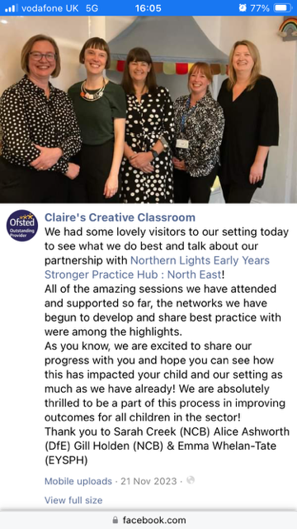
Early Years Stronger Practice Hubs
Being delivered by the sector for the sector – driving system leadership within the early years
Reaching more and more early education settings – with over 7,000 providers now involved in hub networks
Supporting the full breadth of the sector: school-based nurseries, private voluntary and independent nurseries and childminders
Bringing to life evidence-informed practice and supporting settings to use evidence to inform practice
Notes:
I’ve been leading the Stronger Practice Hubs programme within the department since the programme’s inception. My team and I visited some of the hubs towards the end of last year and it was hugely exciting to see just how far the hubs have come and the impact they are now having across the country.
Today is an opportunity to hear directly from the hubs so I’ll keep this intro brief. But I want to take the opportunity to reflect briefly on some of my reflections of the programme so far.
Firstly, led by the sector for the sector. We and colleagues at NCB have set parameters for the programme and objectives, but hubs have been coming up with their own ideas on how best to bring this programme to life on the ground. It’s been really exciting to see that leadership coming from within the early years sector. I’ve met so many committed, passionate staff in my visits.
And we’re seeing that settings are responding and really want to hear what the hubs have to say – now over 7,000 early years providers involved in networks and that number is growing month on month.
Hubs have really grasped the challenge of reaching the full breadth of the sector – so making sure they have an offer for group-based providers but also for childminders who we know often find it more difficult to find training and support that works for them. Image on the slide is of a visit I made to the childminder partner of the Northern Lights hub in Sunderland who plays a key role in making sure the hub’s offer is meeting childminders’ needs. Some of you will hear more about their childminding work in one of the workshops later.
Hubs are finding creative ways of showcasing for settings why using evidence to inform practice is important and what that looks like in practice – through blogs, webinars, open days. That message is so much more impactful when it comes from someone who is implementing this in their own practice and understands your context.
So I want to say a huge thank you to all of our hubs for coming on this journey with us and rising to the challenge with such commitment and enthusiasm.
And to those of you who are hear to learn more about the hubs programmes – I hope some of you are here because you’re already in touch with your local hub and that’s made you curious to learn more. Thank you for getting involved. And if you haven’t yet engaged with your nearest hub, do find out what training and support they have running in your area. We know this has been a tough few years for the sector as we’ve slowly emerged from the Covid pandemic – your hub is there to help.

Slide 8
Overview of the SPH Programme
Gill Holden
Early Childhood Programme Lead National Children’s Bureau

Slide 9
NCB – Delivery Partner

Slide 10
Aim
To help pre-reception early years settings adopt evidence-based practice improvements to address key Covid recovery issues, and build trusted networks for sharing effective practice

Slide 11
What is a Hub?
A partnership of strong providers of pre-reception early years education with sound expertise and knowledge of the evidence base on what works to support child outcomes – trusted local experts that other early years providers can look to for advice and support

Slide 12
What Hubs do?
Establish or build on local networks of settings (including childminders) to share knowledge and effective practice
Proactively share info and advice on evidence-based approaches, e.g. through newsletters, blogs and social media
Act as a point of contact for bespoke advice, and signpost to other funded support
Work with the Education Endowment Foundation to select evidence-based programmes to fund and make available to settings

Slide 13
Delivery Partner Role
NCB Focus: Enabling Hubs to deliver a robust package of evidence-informed support to their local sector
Monthly 1-2-1 meetings to review Hub Delivery Plans
A programme of learning opportunities for the Hubs to upskill them in their role as Hub
Provision of peer support opportunities
A Quality Assurance Framework to guide the work of Hubs
A central SPH website managed by NCB
Link in with other covid recovery programmes
Joined up support with EEF to ensure Hubs continue to strengthen their use of evidence and research

Slide 14
The Hubs
North East
Northern Lights EYSPH
The Great North EYSPH
Yorkshire & Humber
St Edmund’s EYSPH
Yorkshire and Humber Together EYSPH
North West
Bright Futures North West EYSPH
Liverpool City Region and Beyond EYSPH
East Midlands
East Midlands EYSPH
Derbyshire and Nottinghamshire EYSPH
West Midlands
HEART – Midlands EYSPH
Thrive Together EYSPH
East of England
East of England EYSPH
REACHout EYSPH
South West
Bristol & Beyond EYSPH
EY South West, EYSPH
London
Brighter Start: East London’s EYSPH
London South EYSPH
South East
Thames Valley EYSPH
Kent EYSPH

Slide 15
Stronger Practice Hubs website
See highlights from the Hub’s support offer
Gain an overview of the programme
Find your local Hub, browsing by Hub or by Region
Contact your local Hub, see what they have on offer, download their resources
Gain an overview of other relevant covid recovery programmes
Link to EEF Early Years Evidence Store
https://www.strongerpracticehubs.org.uk/

Slide 16
Evidence Partner - EEF
Sarah Tillotson
Early Years Lead Education Endowment Foundation

Slide 17
Hubs Our Journey So Far…

Slide 18
Emma Whelam-Tate Northern Lights EYSPH

Slide 19
“Coming together is a beginning, keeping together is progress and working together is success.”

Slide 20
Childminder: a person whose job is to take care of other people’s children in her or his own home:
Notes:
Key words – a person – job – care – own

Slide 21
Current landscape of Childminders within the Childcare Sector​
Over time the childminding role has developed and altered as a result of social and political influences (Aaronricks, 2023). The childminding role is complex (Basford, 2019). Childminders must register with Ofsted or a childminding agency (which is self-registered with Ofsted) and are also guided by the Early Years Foundation Stage (EYFS) Statutory Framework (DfE 2023). ​
​
Childminders have a critical role in the provision of early childhood education and care (ECEC) and yet, based on current trends of decline, are predicted to have disappeared from the sector by 2034 (PACEY, 2019). ​
​
Russell (2021) reported that further decline is predicted, because of the devastating impact of the Covid-19 pandemic, which had a particularly damaging effect on childminders and their childcare businesses. ​
​
Childminders continue to feel inadequate with little consideration and awareness of their unique needs within the Early Years sector (Lawler, 2022).​
Childminders are recognised as the longest form of paid childcare in England; however, it is an underdeveloped area of research (Aaronicks, 2023).​
Notes:
Research has told us that:

Slide 22
Our local intelligence told us that……
Notes:
Our local intelligence supported our research findings which told us that childminders felt: alone, isolated, unheard, undervalued, unsupported, being a childminder is extremely hard work, work long hours for low pay, aren’t seen as equal or professionals, babysitters
LISTENED!
X3 areas across 10 LA’s
Communication Friendly Settings
EY Network meetings (6-7)
Face to face with children – Nature Pioneers: Forest and Beach School, Tiny Tweeties
Pacey Webinars
NPQEYL
Social Media
Monthly feature on newsletter
Blogs
Take Away Concept

Slide 23
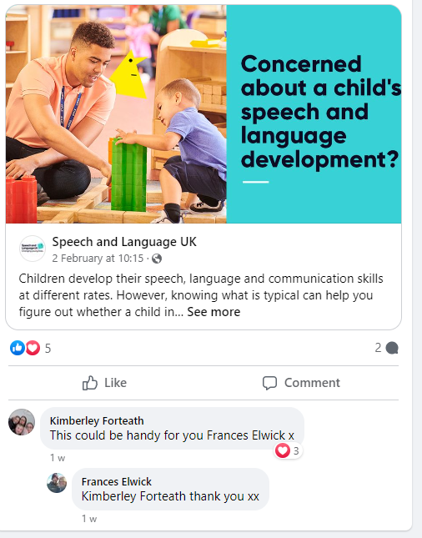
Nature Pioneers
So we……
Listened
Notes:
Why - Needs analysis of childminders – face to face interaction, PD for childminders needs careful consideration, time day etc – Top 3 areas – CL, PSED, SEND, Survey – lack of confidence in using outdoor spaces - sustainability model – how to use outdoor spaces as a tool to support learning and development –
EEF - Elklan's Communication Friendly Home-Based Setting - regular PD sessions, SL tutor, upskilling staff with CL (
NPQEYL – childminders accessing this in NE
EY Network meetings (6-7) Face to face with children
Nature Pioneers: Forest and Beach School, Tiny Tweeties X 3 AREAS - Take Away Concept - including resources for sustainability - see/model evidence informed practice and high quality teaching strategies support key areas of need
Pacey Webinars
Sharing the narrative through:
Social Media
Monthly feature on newsletter
Blogs

Slide 24
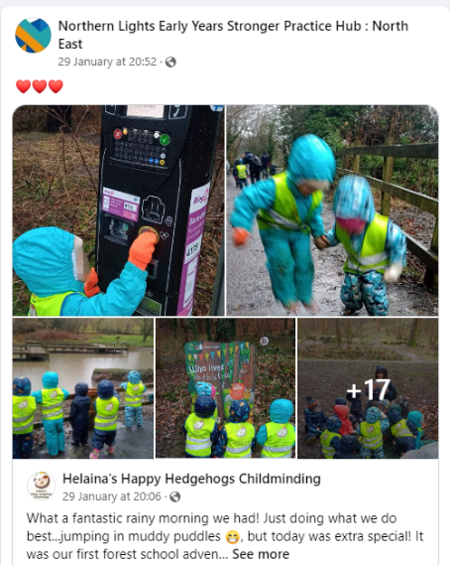
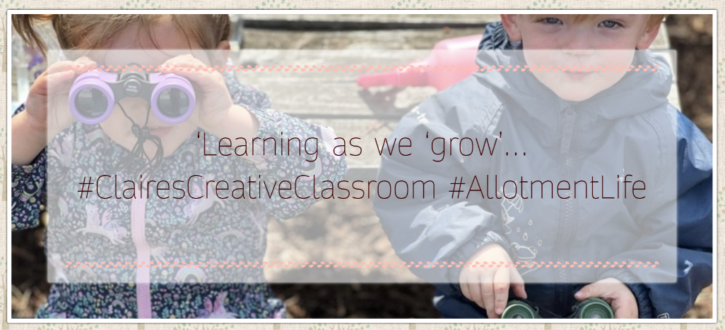
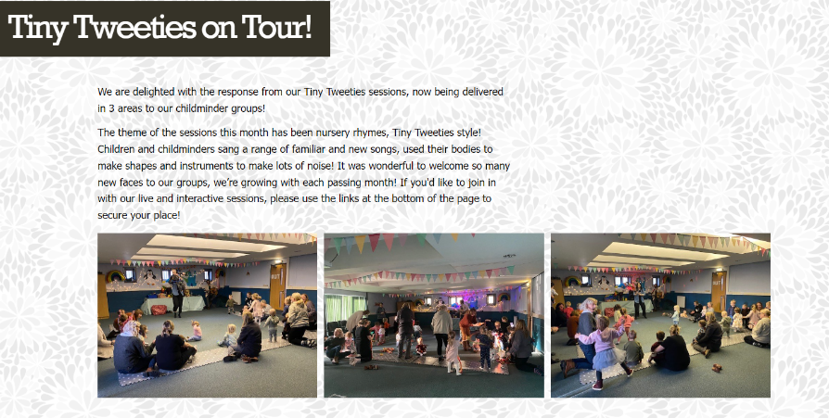
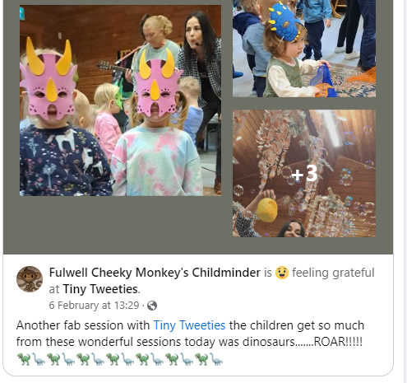
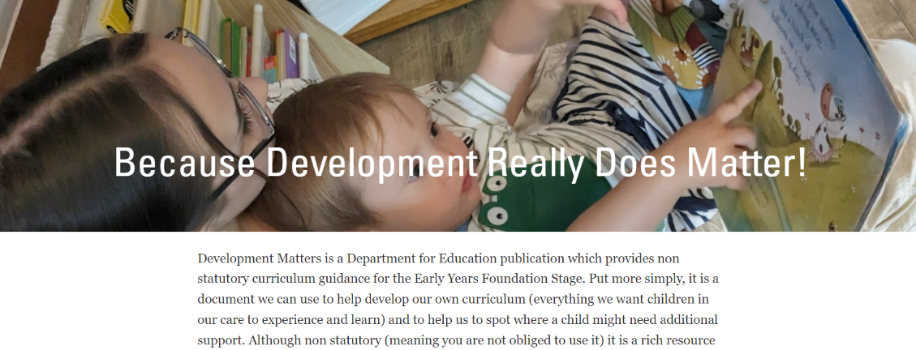
Raising the profile and sharing the narrative…..
Voice
Notes:
Sharing the narrative through:
Social Media – 500 plus followers – childminders have a strong presence on the page
Monthly feature on newsletter
Blogs x 2

Slide 25
Childminders are telling us that…..
"You've not only changed the way we think about learning but you've changed our practice for the better. We feel much more confident now. Thank you for bringing us together again.”
Notes:
Childminders are telling us that: PD is suitable for 0-5, children gain so much from the experience when involved, having strategies modelled first hand is invaluable, resources to implement at home are crucial, CL underpins all we do, know where to access evidence and how to use this in my practice to support better outcomes for children

Slide 26
Kady Steel Early Years South West EYSPH

Slide 27
Our Journey In Collaboration With The EEF

Slide 28
Assessing the Need
As we began our journey as a hub, we started to receive feedback from practitioners about what support they needed and it quickly became clear which areas we needed to plan for as a priority.
Key headlines started to emerge:
Communication and Language
Behaviour
Emotional Regulation
Programmes are chosen by the Hubs based on the need of the area
Notes:
When we began our hub journey, we immediately began to send out surveys to all practitioners to assess the need. There were 3 key areas which came back as a high area of need. As the EEF were releasing brochures to select programmes, we used this information to prioritise and order our selection.

Slide 29
Current EEF Projects for EYSWSPH
Notes:
Over the journey so far, we have been allocated the following programmes.
All of these programmes are at different stages of development and therefore have differing levels of evidence of whether they work to improve child outcomes and this is what we are testing through these programmes. For some of the programmes, we were also able to be allocated extra spaces.
We are still recruiting to some of these programmes now.

Slide 30
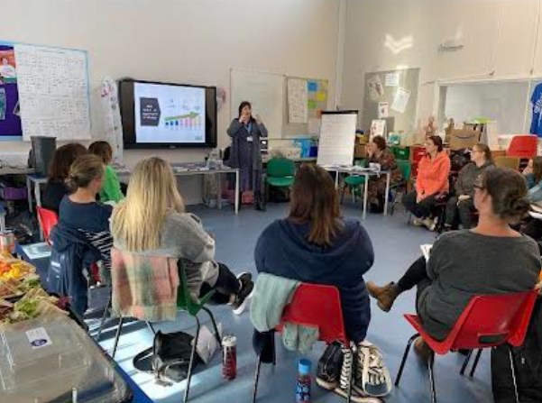
Recruiting Settings
Worked with programme providers to create suitable advertising/promotional material
Ensured that team members were aware of programme content to lead advertisement
Provided accessible programme material for the team to use when visiting settings/attending events
Assessed which settings/childminders are in the highest areas of deprivation
Focussed recruitment to programmes from specific areas first
Gained support from key stakeholders such as local authorities to understand which settings are in need
Had regular communication with programme providers to keep updated on recruitment
.
Notes:
The Hub plays a vital part in recruiting settings to apply for the EEF programmes. We work closely with the programme providers to ask for suitable accessible advertising and promotional material. Some of the programme providers have made videos to discuss the content of the programme, they have ran Q+A sessions for practitioners to attend and have also provided flyers. Most programme providers have also offered to attend any events that we are hosting.
We ensured all team members were aware of the content of the programmes so that when they were in contact with early years practitioners they can advise which programme would be suitable for their setting.
As a hub, we collected data on which settings were in the highest areas of deprivation and we have therefore sent the recruitment material to these settings.
The hub have then been a support network for the settings who are involved in these programmes. This could be for technical support or more specific support.

Slide 31
Success and ongoing support
We have fully recruited to 3 EEF programmes so far.
We have received above recruitment target numbers of expressions of interest for the 3 EEF programmes which are still being recruited to.
As a hub, we have offered support to settings who have signed up to EEF programmes.
We are now planning for the practitioners linked to the different programmes to continue networks.
Notes:
We are fully recruited to Maths Champions, Early Talk Boost and Chatterbugs.
We are still currently recruiting to ELKLAN. Emotion coaching and NELI P.
A barrier that we have come across as a hub is that settings have signed up to a programme but have then preferred another option but they are only able to sign up to one EEF programme. A way that we have overcome this is to communicate with the settings as early as possible to let them know what options are coming so they can assess the need within their setting.

Slide 32
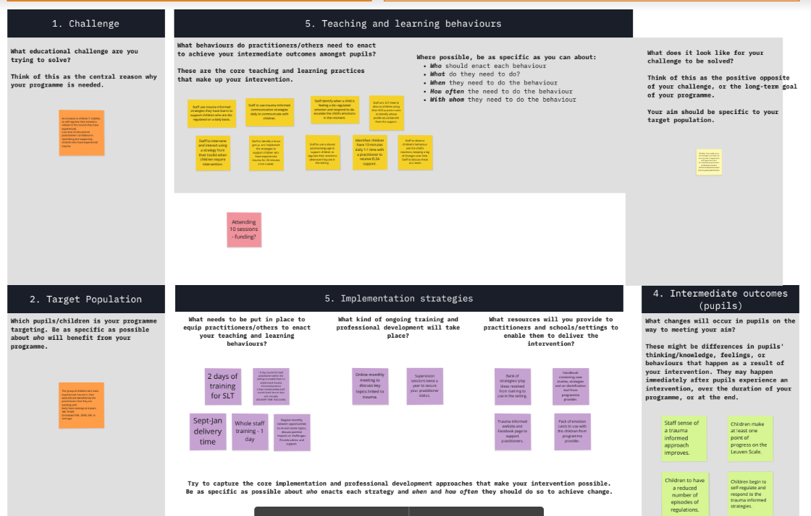
Applying for a Development Programme with the EEF.
We were really keen to apply to develop a programme with the EEF as we saw this as a great learning opportunity
We were successful with this application process
We completed 6 online workshops led by the EEF to build this programme.
Workshop 1: Theory of Change
Workshop 2: Understanding Barriers and Enablers
Workshop 3: Designing an Implementation Strategy
Workshop 4: Developing an Effective Feedback Plan
Workshop 5: Feedback Tools & Recruitment Process
Workshop 6: Collecting and Learning from Your Feedback
Notes:
Another fantastic opportunity that we have had as a hub is to apply for funding to develop a programme that is needed within our area but currently does not yet have the evidence to support larger roll-out. This was a great learning opportunity for us as a hub. We were .able to fully recruit to this programme and deliver it successfully/

Slide 33
Sally, Victoria, Andrina & Natalie Thrive Together EYSPH

Slide 34
Notes:
First wave Hub; we quickly established our partnerships with 2 private nurseries and a child minder and set up a Strategic Board which well-represented the sector to agree our vision for Thrive Together …

Slide 35
An overview of Key Outcomes:
Establish a strong hub identity as a trusted EY source
Match national agendas to local need - vehicle for 2 way communication
Target most deprived areas to distill practice
Unite and celebrate the sector in our area, removing barriers and creating opportunities to flourish
Target communications for busy educators
Move early into all LA areas within our reach through LA Leads, to build trust and establish relationships for greater SPH impact.
…Thrive Together SPH is being recognised as a trusted source for EY in the system, in a relatively short space of time.
Notes:
SM . 15 months on, we have… established both lead practitioners ourselves and a strong identity as a trusted source
Matched national agendas to local need - vehicle for 2 way communication with NCB/DfE and the sector
Targeted most deprived areas to distill practice - to close disadvantaged gap
Unite and celebrate the sector in our area, removing barriers to collaboration and engagement and creating opportunities for all to flourish - with equity of access for childminders and PVIs
Moving early into areas within our reach, other than our 'home turf' in Walsall, very early on in the evolution of the Hub, to begin to build trust and establish relationships so that Thrive Together could have greater impact.
We have successfully built professional links with all LA leads within our area, joined their networks and delivered CPD - becoming a trusted source for EY across the hub area within a short space of time.

Slide 36
Demographics of our
Hub area
Notes:
SM Walsall and Stoke PEIA - high deprivation and low outcomes.

Slide 37
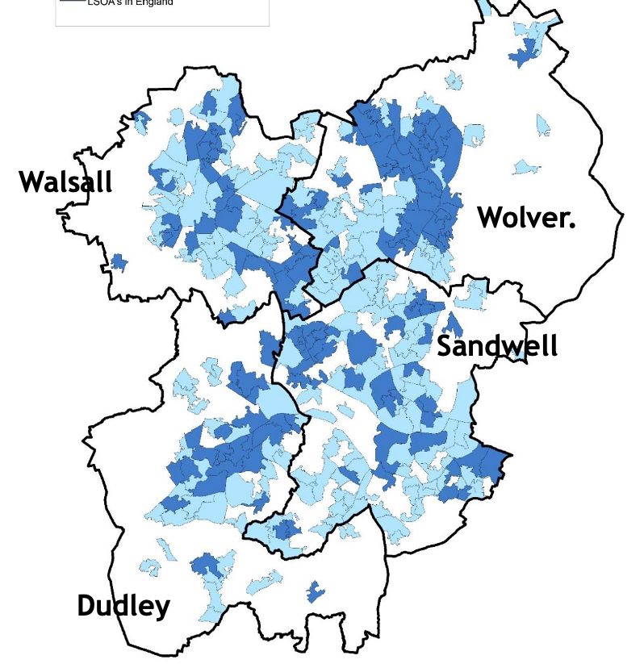
Targeting those most in need
Deprivation ranking | National ranking | % of LSOAs in %10 Most deprived
Sandwell | 8th | 20%
Stoke-on-Trent | ^{13th} | 32%
Wolverhampton | 16th | 21%
Walsall | 26th | 26th (3rd largest increase nationally)
Telford & Wrekin | 71st | 17%
Dudley | 74th | 11%
Shropshire | 100th | 1%
Staffordshire | 115th | 0%
“I really liked how the Hub delivered open days at Ryders Hayes and Fullbrook Nursery. This brought the SPH to life and developed people's confidence that the SPH itself was rooted in secure evidence informed practice at the core, building the SPH's reputation as a trusted source”. Helen Gibson, Staffordshire
“Telford and Wrekin have been engaging with the Thrive Stronger Practice Hub for 6 months, this has been a very positive experience leading to plentiful CPD opportunities for our EY practitioners.” Lisa Seymour, Telford
“This has been the best recovery programme I have been involved with because it leads to measurable improved outcomes for Walsall (and other) children and improved professionalism in the workforce” Nicola Hart,Walsall.
ncb.org.uk
Notes:
AF - Aside from the Black county, where we have historically worked, we have prioritised establishing relationships with our most deprived wider region, for example ring fencing programmes for most deprived postcodes.
The Quotes from LA leads evidence our added value in our area.The relationship is two ways, we pull together local intelligence to feedback to NCB/DfE “Acting on the system rather than in it”.

Slide 38
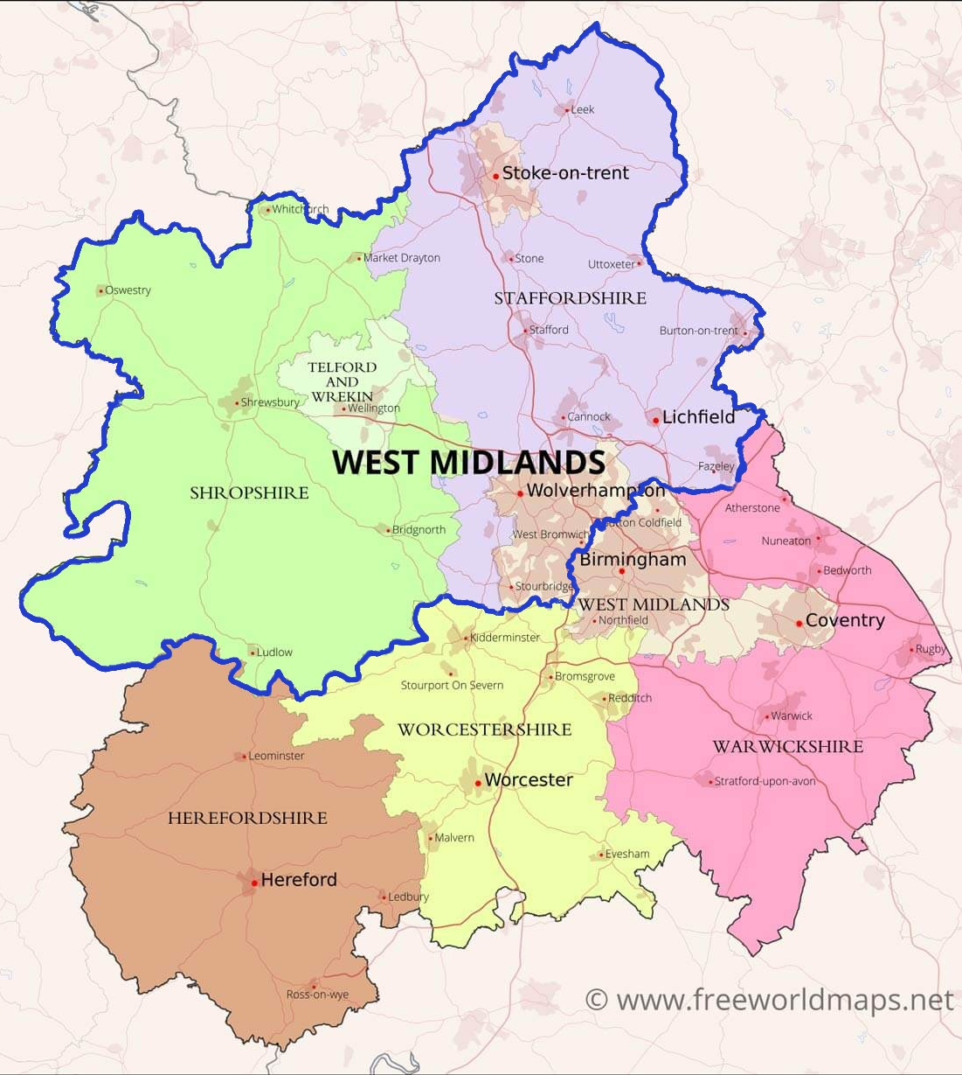
Early contact with LA Leads
& Establishing Trust
Early February 2023, met with the LA leads to establish our role and understand their needs.
Continue to nurture these trusting, professional collaborative relationships.
Attended regular network meetings and conferences across the region.
Offered support to settings across the entire reach area in many different forms, both remotely and face to face.
Used local intelligence to write 3 successful bids for EEF development programmes.
Collaborated with other Hubs and Area Leads and Experts (incl Childminder Leads)
Created local bespoke programmes.
Strengthened and supplemented existing networks
ncb.org.uk
Notes:
AF Very early on in our SPH journey, a strategic decision was made to establish a good working relationship with the local authorities outside our ‘home patch’ of Walsall to secure reach and success as a Hub.
As early as February 2023, we met with the LA leads from Staffordshire, Telford & Wrekin, Shropshire and Stoke on Trent to establish need in their areas; existing provision and to highlight gaps.
Used this intelligence to write bids for EEF small pilot development projects; create local programmes through bespoke development project templates to NCB and also raise awareness through social media about existing provision. Bridge between evidence store and high quality trusted research and the practitioner in their setting.

Slide 39
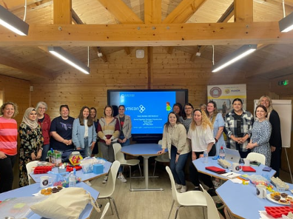
SPH presence at
conferences & networks
We have strengthened the networks within our home area of Walsall, always evidence-informed, and have assumed responsibility for the network meetings formerly run by the Local Authority, as well as their programme of CPD as the trusted source.
We have worked closely with Area Leads and Experts (including for Childminders) for a joined up approach
We have also supported conferences and network meetings in our other authority areas such as Stoke on Trent & Telford & Wrekin to engage practitioners in the Hub, build relationships and distill our SPH offer.
ncb.org.uk
Notes:
AF Our Strategic Board board has evolved to provide strong partnerships and leadership for the Hub’s direction and sustainability across the region. Having representatives from LAs.
We’ve collaborated with other Hubs, an example being forming regional childminder Expert/mentor Network with Heart (partner in West Midlands)

Slide 40
Uniting the sector
Our goal for our Celebration Conference was to ensure that all EY providers including childminders, and Early Years practitioners from our entire reach area could network together, uniting the sector, as well as benefiting from a high-quality, evidence-informed CPD event.
The venue chosen is in the centre of our reach areas, which means it is accessible to all of our local authority regions; with national keynote speakers and workshops to suit everyone within the sector.
ncb.org.uk
Notes:
VD: Theme to link with anticipated launch of DfE Cultural Educational Plan - able to sit on EY Round Table ( ref influencers in the sector and this is the reason for the theme - )
Unite, celebrate. Local intelligence telling us about the need for a deeper understanding of what constitutes and ambitious, sequential curriculum, including outdoor learning. phonological awareness

Slide 41
Creating communities of practice
as a sustainable approach
Strategic ring-fencing of projects to specific areas to create local communities of practice
An online community space to bring communities together where geography is a barrier
Distilled EEF Evidence Store at a local level with a local voice, to meet local need.
Case studies and celebration of success post-training - creating champions and advocates for programmes in each area
Engaging the support of LA leads and existing structures e.g. Hub network model in Telford, to disseminate good practice and curate
Use of social media to engage hard-to-reach practitioners and encourage peer support where time is a barrier
Collaborative working with other hubs
ncb.org.uk
Notes:
VD Evidence Store - Webinar Wednesdays - delivered by local experts who understand the context in which practitioners are working.
Plan - community of practice for every programme delivered - with Thrive Together as catalyst and facilitator
All about collaboration

Slide 42
Distilled EEF Evidence Store at a local
level, with a local voice, to meet local need
Quote from Nicola Hart, Walsall Early Years LA Lead;
The programmes you have selected reflect the local authority and national needs and are driving improvement in those areas, leading to better outcomes, particularly in the areas of Communication and Language, PSED, Maths and Literacy. The programmes are being received very well and due to the depth of delivery are resulting in improved environments, interactions, adult-led and child-initiated learning.
The Webinar Wednesdays and newsletter are also of high quality and reflect key topics and research. The networks are an essential platform for schools and settings to become informed about national and local updates.
ncb.org.uk
Notes:
VD Evidence Store - Webinar Wednesdays - delivered by local experts who understand the context in which practitioners are working
Plan - community of practice for every programme delivered - with Thrive Together as catalyst and facilitator
All about collaboration

Slide 43
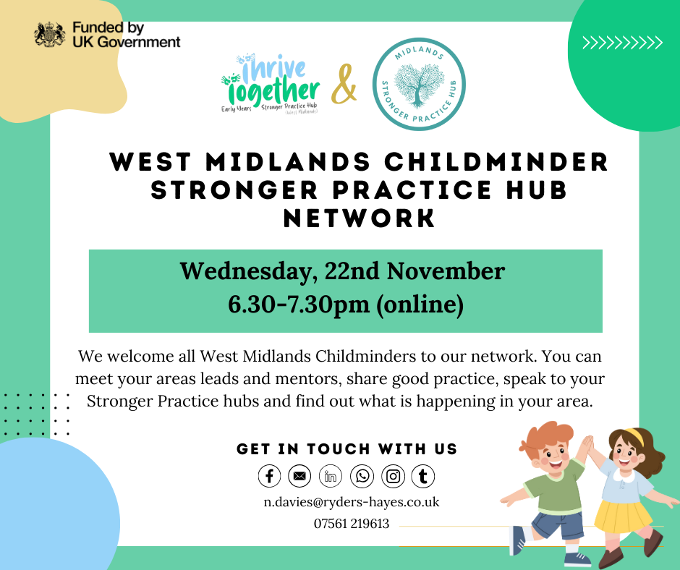
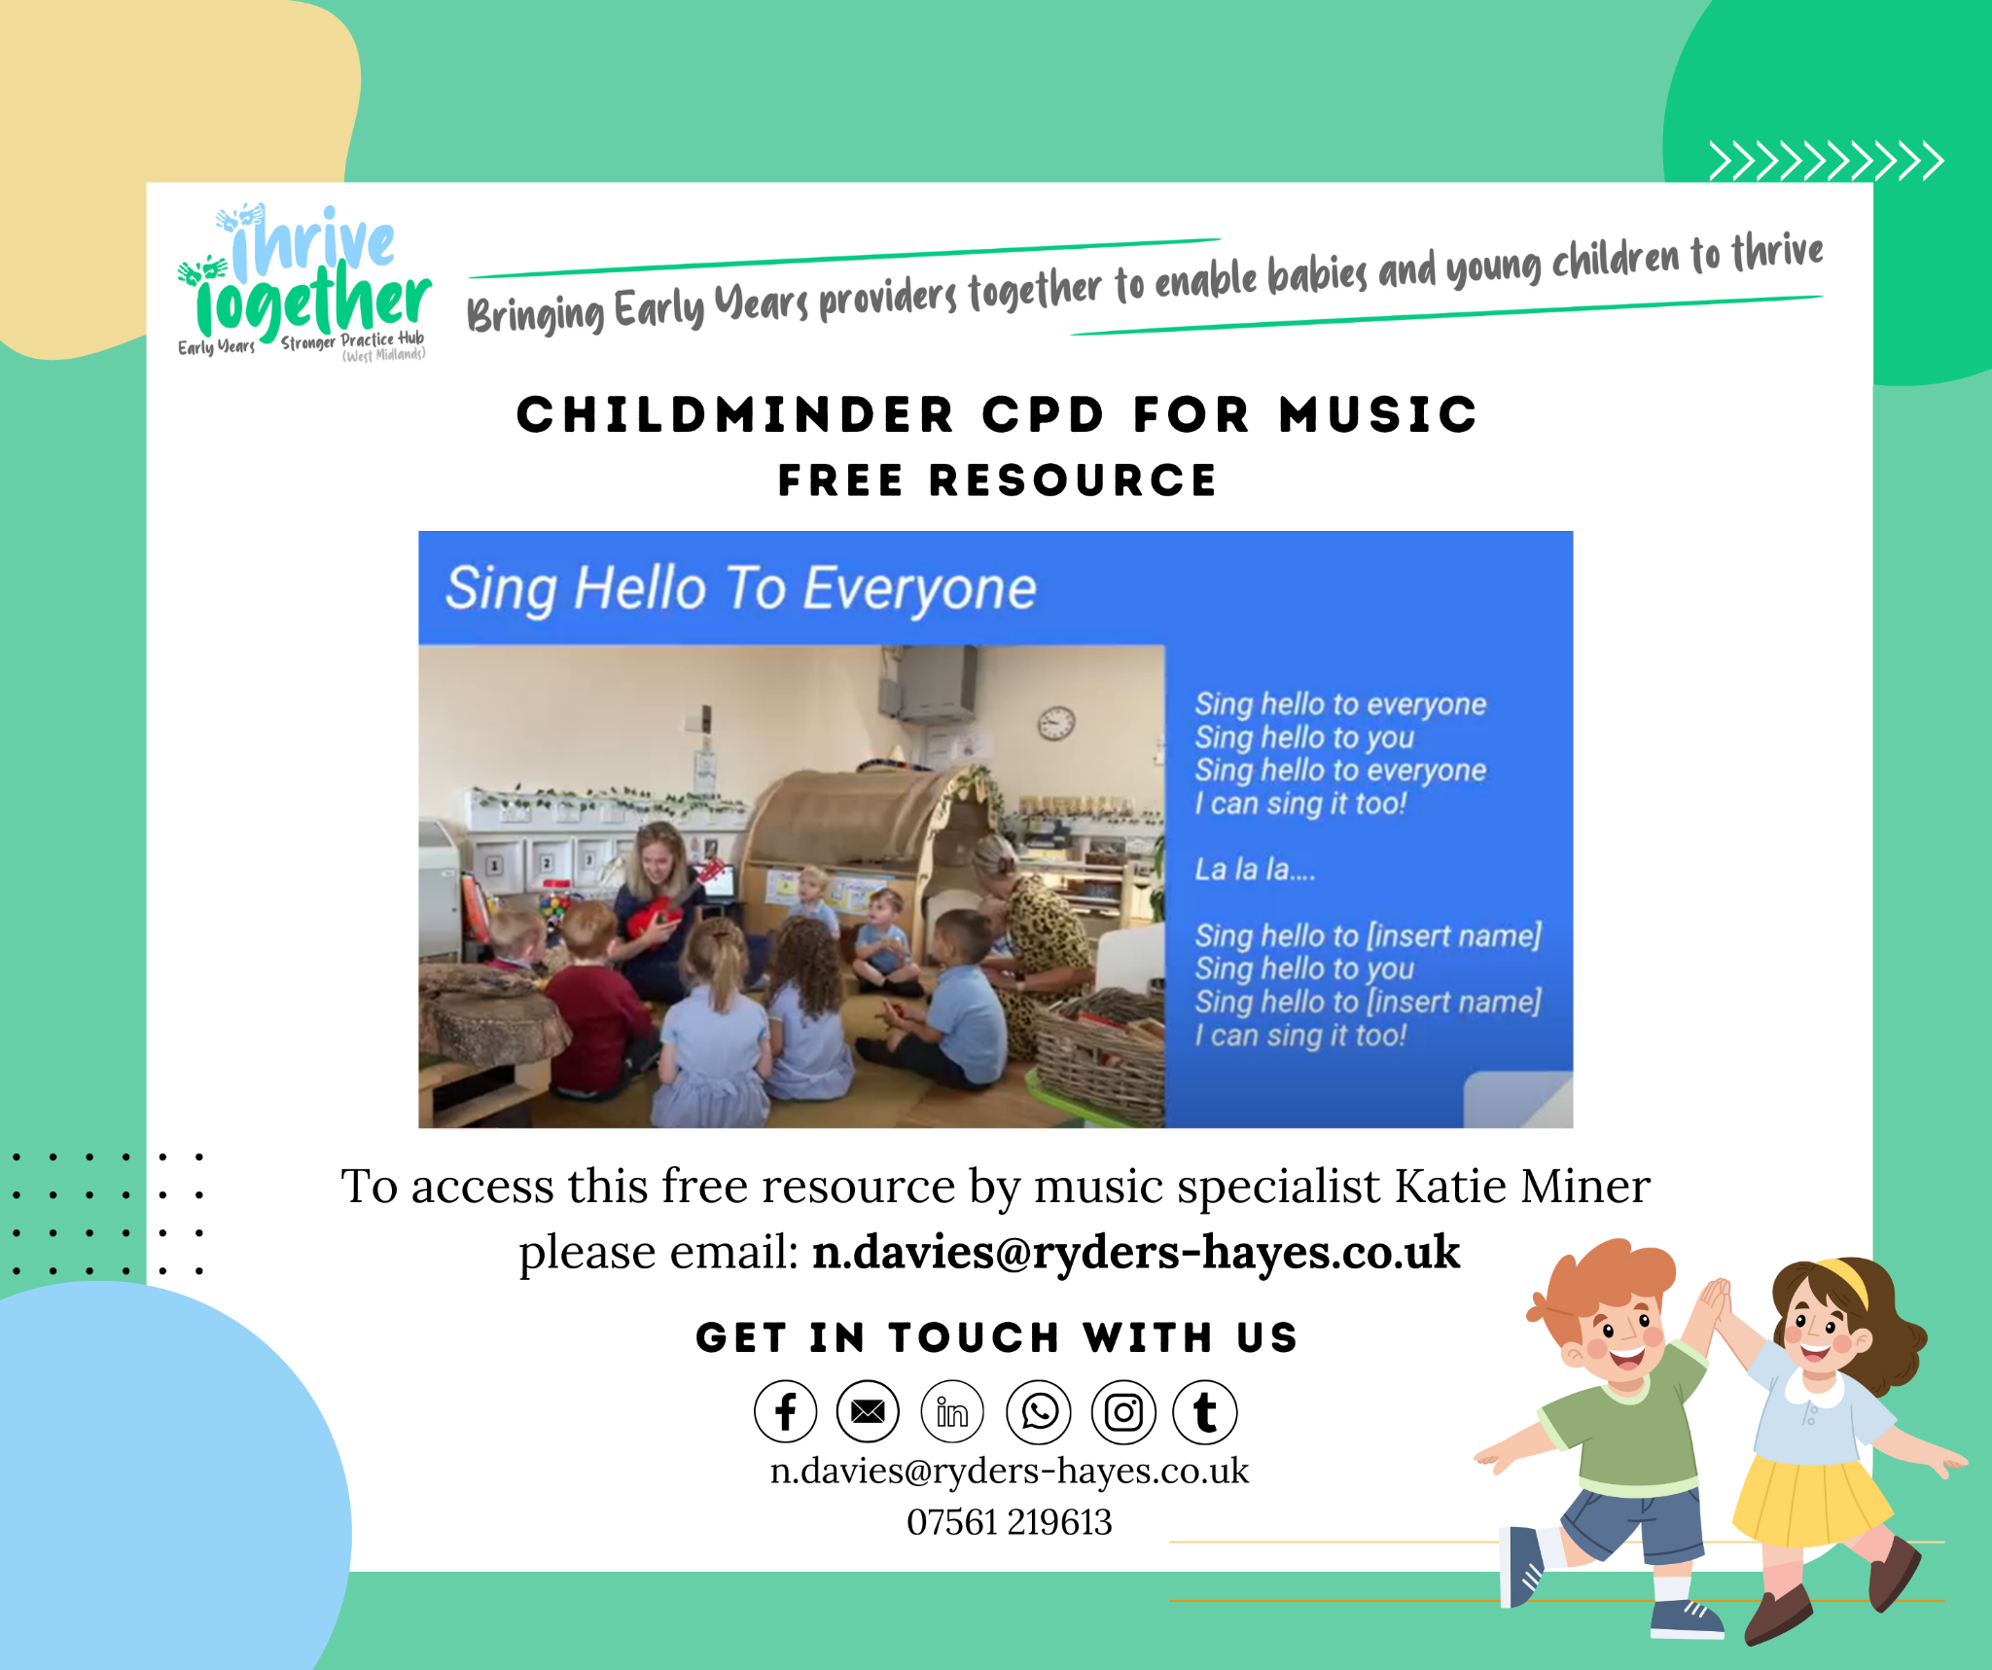
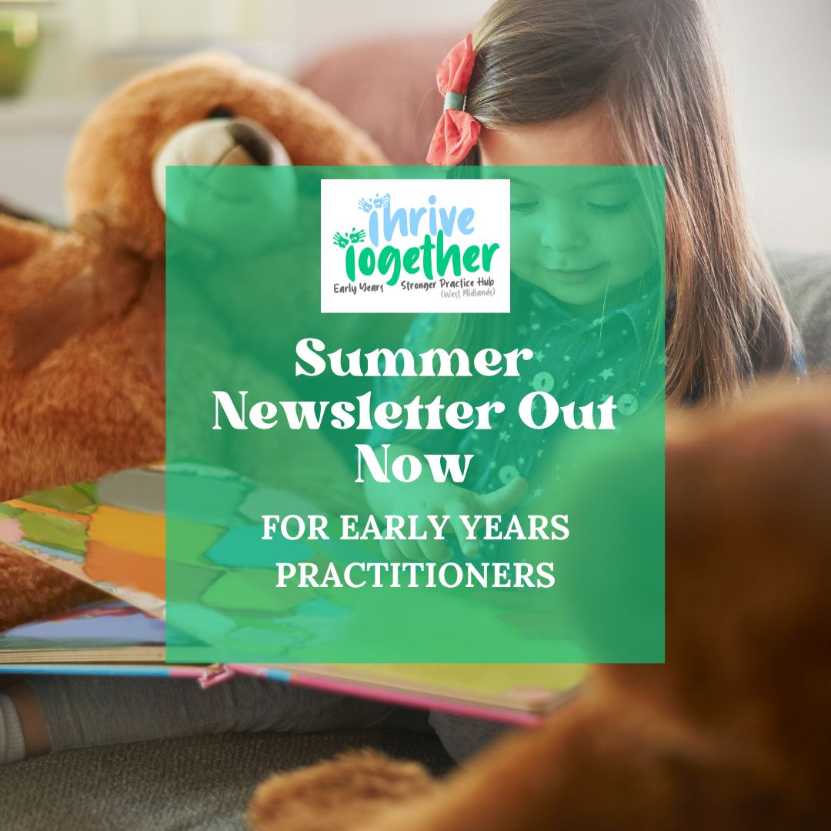
Targeted communications for busy educators
Use of social media and existing frameworks to promote SPH
In the last 30 Days…
Reach: Up by 612 new practitioners
Open Rate & Click Through Rates - November 2022 - February 2024
16580 email sends
7151 opens (45%)
2494 clicks (16%)
ncb.org.uk
Notes:
Using our CRM system we are able to set up multiple lists dependent on provider type and authority location, so that the information that we are distributing through The Hub, is going to the right sector/area. Instead of bombarding the sector with multiple emails that might not be relevant we are instead able to distil this information and ensure that specific information is reaching the right people. This is also shown within our newsletter where we can have dedicated sections for each provider type.
We are also keen to harness the expertise of the sector through blogs and case studies which are then distributed to all settings in our reach area through the newsletter.
Branding is consistent so we can be easily identifiable as a trusted source within the EY sector
Social media right from the outset was going to be key to our success due to how we know different sectors working

Slide 44
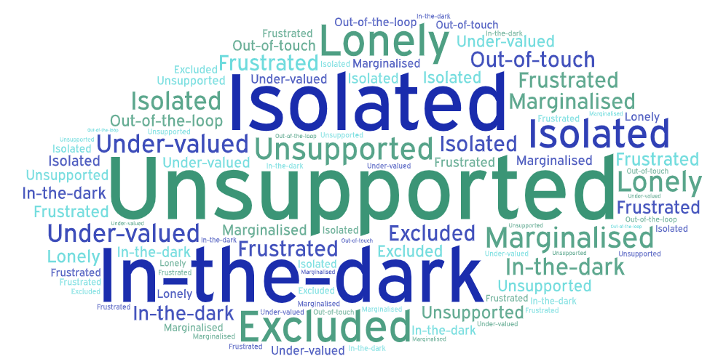
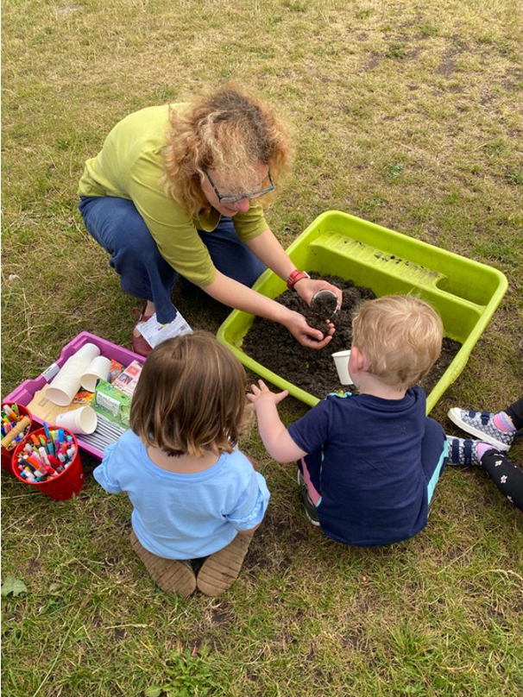
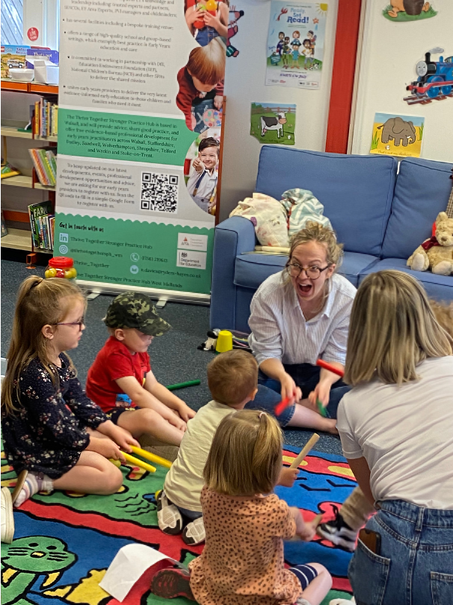
Championing Childminders
They said…
We did…
included childminder representation on our Strategic Board,
negotiated flexible training (evenings and weekends) &/or asynchronous training from programme providers, as well as offering NPQEYL to childminders as a cohort, including use of relevant case studies
collaborated with programme developers to enable childminder access to programmes through carefully planned delivery, sharing of resources and peer partners.
pump-primed childminder ‘play and stay’ sessions in several LAs as a vehicle for accessible and innovative CPD
used social media to join people up and connect them
“”Unlike settings, I am unable to get cover like a manager would to attend training during the day, so a programme like NPQEYL would have been out of reach, and I would have been left out. The bespoke NPQEYL programme allows me to attend Saturdays and late evening training sessions which is ideal for me.”
Cindy - Childminder Telford
Adapted NPQEYL Cohort
ncb.org.uk
Notes:
SM: We have been relentless in championing the voice of childminders, since early feedback from our initial childminder focus group, where feelings of being forgotten and excluded from training and development enjoyed by the rest of the sector, were strong.
As a result, we have a Childminder partner on our Strategic Board, who shares feedback and provides a constant reminder as to how their needs could be met.
We support the sector using our social media channels, but with childminders have very limited access to their emails during the day that the use of social media and platforms such as WhatsApp were much more accessible. Therefore we took this feedback on board, and created separate facebook group pages for each sector type, and have a dedicated WhatsApp group for Childminders within the Walsall area, which we hope to replicate for our other local authorities. Dedicated space in the SPH newsletter. Trialled pop-up enrichment & engagement sessions in hard to reach areas to support depth and breadth of their offer. Supported a childminder network
So as you can see - we’ve made a good start in the limited time we’ve had, but we are really only just beginning… With anticipated demand post-April for the expansion offer, we need to be there to support settings and a new workforce with the challenges ahead, as well as strengthening our partnerships with other stakeholders to act on the system, with a joint mission, of giving our children the best start in life. .

Slide 45
Championing Childminders - Feedback
“”Unlike settings, I am unable to get cover like a manager would to attend training during the day, so a programme like NPQEYL would have been out of reach, and I would have been left out. The bespoke NPQEYL programme allows me to attend Saturdays and late evening training sessions which is ideal for me.”
Cindy - Childminder Telford
Adapted NPQEYL Cohort
“The SPH has made me feel included and providing opportunities for us to come together which is nice as I am often working alone in my role as a childminder. Programmes such as Wellcomm and Numicon were adapted so that I could attend at a time that worked for me during my working week. Recordings of sessions were made available so I could watch them in my own time or go back to them. I feel there is a sense of community and I feel included in this. Last Wednesday I had Ofsted where I achieved a strong ‘Good’. The inspector was impressed with my involvement in the SPH programmes and could see strength in my practice as a result of this ”
Kara Nicholls - Walsall Childminder
ncb.org.uk
Notes:
SM: We have been relentless in championing the voice of childminders, since early feedback from our initial childminder focus group, where feelings of being forgotten and excluded from training and development enjoyed by the rest of the sector, were strong.
As a result, we have a Childminder as part of our Strategic Board, who shares feedback and provides a constant reminder as to how their needs could be met.
We support the sector using our social media channels, but with childminders have very limited access to their emails during the day that the use of social media and platforms such as WhatsApp were much more accessible. Therefore we took this feedback on board, and created separate facebook group pages for each sector type, and have a dedicated WhatsApp group for Childminders within the Walsall area, which we hope to replicate for our other local authorities. Dedicated space in the SPH newsletter. Trialled pop-up enrichment & engagement sessions in hard to reach areas to support depth and breadth of their offer.
So as you can see - we’ve made a good start in the limited time we’ve had, but we are really only just beginning… With anticipated demand post-April for the expansion offer, we need to be there to support settings and a new workforce with the challenges ahead, as well as strengthening our partnerships with other stakeholders to act on the system, with a joint mission, of giving our children the best start in life. .

Slide 46
Diane Jeffries The Great North EYSPH

Slide 47
Stronger Practice Hubs Learning and Dissemination Event
29th February 2024
Notes:
Introduction

Slide 48
Hub Infrastructure
GNSPH Strategic Partners
Executive SPH Team
Special Education School
Childminder
PVI
SPH Lead school
Primary School
SPH Governors
NCB
Research School
Early Excellence Nursery
WISE Academies Trustees
Debi Savoy (Childminder)
Notes:
Summer 23.
Hub was approved in July, an Exec. team created and proceeded to set up the GN Infrastructure
SPH Executive Team & CEO, HT (Lead School Haltwhistle Academy), Director for EYs, SPH Lead Practitioner
A strategic partners group was set to represent the range of EY providers – SENDtoLearn (PVI), Cleaswell Hill (Special Education School), Bothal Primary (provision for 2years old onwards), Debi Savoy (Childminder), Goosehill Early Excellence Nursery based in Northumberland & Town End Research school
Accountability:
- SPH Governance & Wise Academies trustees’ Quality assured by NCB
SPH, NCB, EEF, DEF - Key teams working with the SPH leads to coordinate and QA all strands of the EYER programme delivery

Slide 49
GNSPH - Partnerships continued..
National
Partners
NCB
DfE
EEF
Local Authority Partners
Durham
Newcastle
Northumberland
Regional Partners
-Research Schools x 3
-English Hubs
-Area Leads, Experts & Mentors
-University
-SEN Professionals Teams
Local Delivery Partners
A range of nursery setting and childminders identified as delivering high quality evidence informed practice within the local area,
Hartbeeps
SEN Professional Teams
-Dingley’s Promise
-Speech and Language Teams
-Autism Education Trust
-Best Practice
Key Partners – Programme Providers
Elklan, OxED and Assessment, EDT, Pacey, Best Practice
Notes:
The Hub’s National Partners
EEF, DfE & NCB - partners working together with the hub to ensure the package of workforce training, qualifications and support and guidance for the early years sector to help address the impact of the pandemic on the youngest and most disadvantaged children is delivered
Local Authorities
Our strategic partners group also includes representatives from across the hubs 3 x LA’s – EY advisory / development leads for Northumberland (Home Area), Durham and Newcastle – to ensure the hub offer compliments each LA EYs training and support offers
1)Regional Partners
GNSPH working partnership with 3 x Research schools - raising profile / delivering PD on EEF’s evidence informed best practices
1 English Hubs – C& L and phonics preparation focus / 1 English hub – work currently pending
Experts and Mentors programme, leads were contacted and information shared about SPH role and EYER funded packages in addition/ and as part of working together with the ‘experts and mentors’ offering support and guidance to practitioners and childminders working in the early years sector
University links – working with research professors, (partnership to commence spr 2)
2) Local partners
A range of nursery setting and childminders identified as delivering high quality evidence informed practice
3) Key Partners – Programme and Guidance Support Providers
Elklan, OxED and Assessment, EDT, Pacey, Hartbeeps, Dingley’s Promise –working with EY practitioners and childminders to improve the quality of practice grounded in evidence informed practice
4)SEN Professional Teams
SEN Support – Aside from our main strategic / delivery partners who specialise in SEN (Cleaswell Hill special schools, SENDtoLearn PVI provision) the hub is also working with professionals from the Autism Education Trust & in March 2024 will also be offering practitioners opportunities to access the Dingley's promise training, to support practitioners with SEN

Slide 50
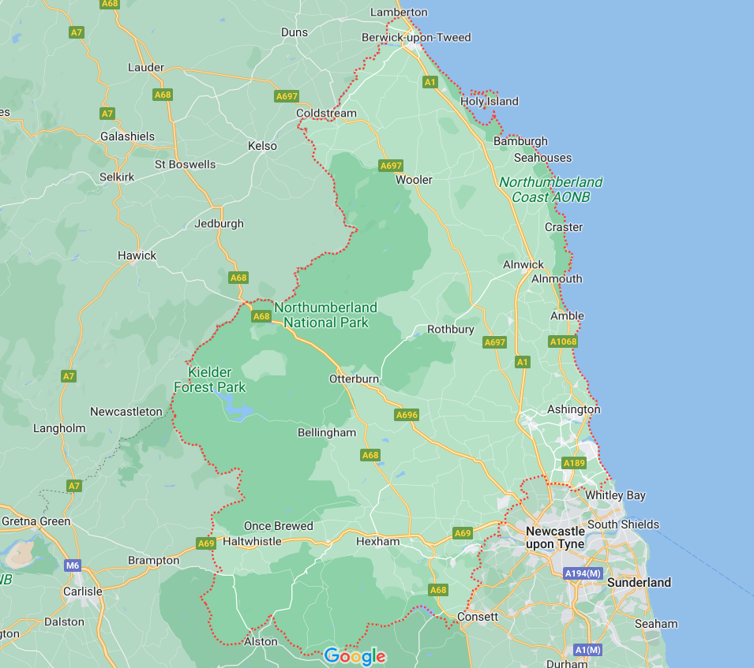
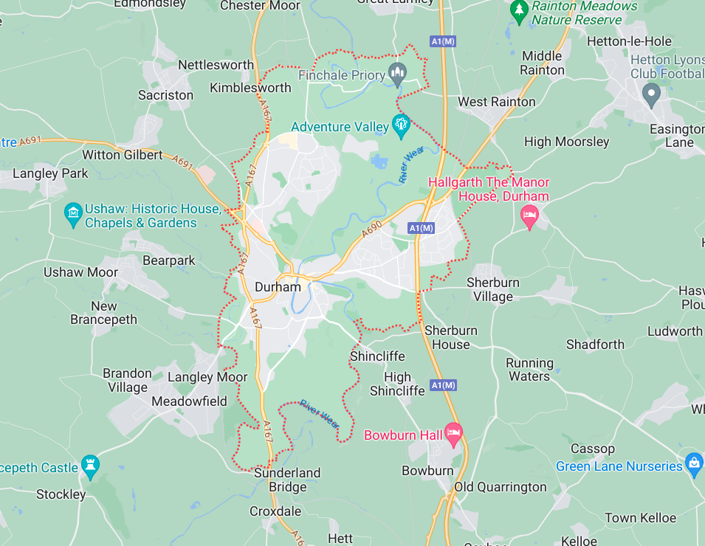
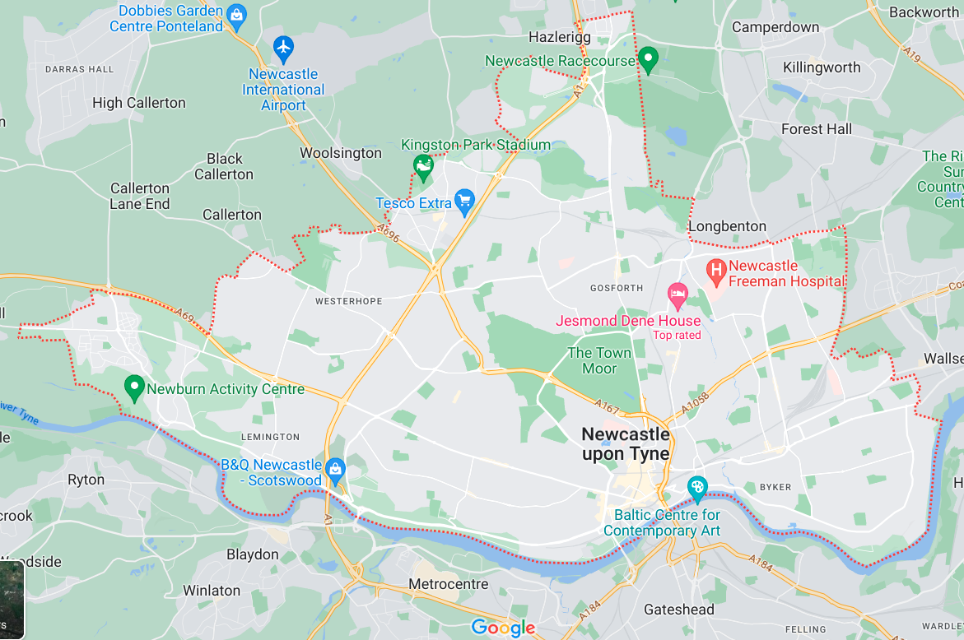
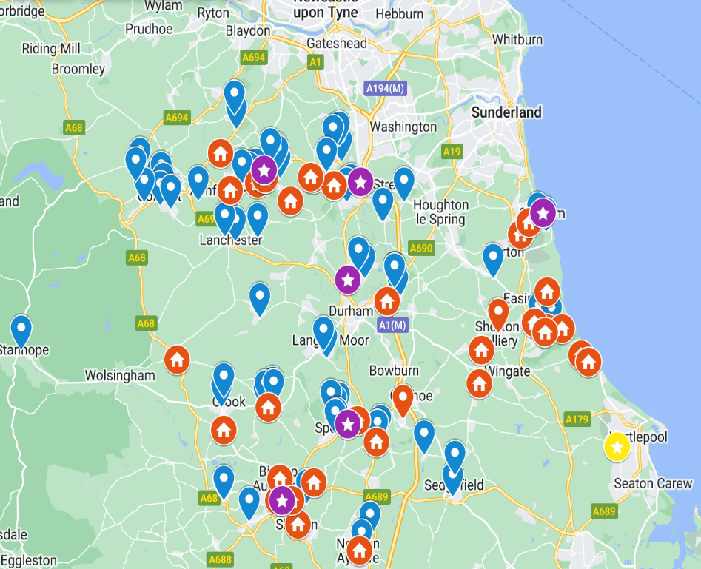
GNSPH: Hub Regions
Mapping Exercise Durham LA: Identification of childminders locations / most deprived areas
Mapping Exercises - Identification of most deprived areas
Notes:
Summer / Autumn 2023
IDACI exercises
- Series of mapping exercises for each LA / settings & childminder locations
- Identification of the most deprived areas / names of settings located within these areas
- Mapping tasks 3 x LA to identify where childminders are located to offer network groups / deliver the PD core offer training for all CMs
Hub director / lead practitioner engaged with all 3 local authority EY advisory teams, gathered intelligence around the challenges, needs and priorities for PD, guidance and support in each LA and discussed details of their local PD offers for EY childminders & settings.
Key priority areas for PD, support and guidance were identified and the GNHub / LA teams worked in partnership, to plan how GNSPH and LAs PD local offers would compliment each others work, in a collaborative approach to support and deliver PD to practitioners across all EYs provider types across all 3 LA’s

Slide 51
GNSPH Launches – EYER Roll Out
DFE £180 million EYs Education Recovery Package
Practitioners, Managers & Leaders in
EYs Settings (PVIs, Childminders and Nursery settings)
The Early Years Stronger Practice Hubs
DFE
CPD Package offer
Additional Funding for Qualifications
EEF & SPH
EEF EYs Evidence Store
Evidence Informed Programmes
SPH
Experts and Mentors
Funded Support and Guidance
NPQEYL
Child Development
SENDCo Level 3
EEF 4 Main Themes
EEF Guidance Reports
Elklan CFHBS & CFS
Signposting settings to
- evidence informed practice
-blogs, case studies
-establishing networks share best practice
Notes:
Autumn Term 2023
Sept. - Dec 23
- 11 SPH launches delivered across 3 LAs, in key locations, targeting the most deprived areas, to share and signpost settings and childminders to the EYER funded packages on offer
- Combination of face to face and virtual launches, delivered during the day, late evenings & weekends to ensure launches were made accessible to and engaged childminders and practitioners from all EYs providers types.
Hub leads used these launches to give EY professionals an overview of what the EYER programme packages consisted of and how PD content and delivery is grounded in upskilling the EY workforce to implement evidence Informed practices, to improve their practice and support children to reach better outcomes.
-The GNSPH work - is part of a package of up to £180 Million for workforce raising qualifications and support and guidance for the EYs sector, to help address the impact of the pandemic on the youngest & most disadvantage children
The package is divided into 3 strands and the hub plays a major role in signposting practitioners to different pathways of funded support, available to practitioners, leaders, EY settings, PVI’s childminders and nursery settings.
Practitioners can access a series of funded packages and evidence informed programmes, that form part of the EYER package, for example as part of the:
- DfE’s list of professional development training packages, practitioners can access training to support their individual professional development pathway training for e.g through the NPQEYL, Child Development, the SENDco courses available
- EEF & SPH’s role: practitioners can access evidence informed programmes that are jointly funded by the EEF & SPH e.g. Elklan CFHBS for childminders & CFS for nursery settings; and also access evidence informed guidance reports and resources from the EEF’s Evidence Store
-The GNSPH:
-signposting childminders and settings to evidence informed funded DfE professional training packages, programmes and the EEF Evidence Store
-supporting settings in adopting evidence-based practice improvements through building local networks for sharing effective practice; sharing bogs and case studies etc.
-working with LA’s professional and local childminders and nursery settings to deliver the GNSPH PD training and support package offer for 2023/24 bespoke to local priorities

Slide 52
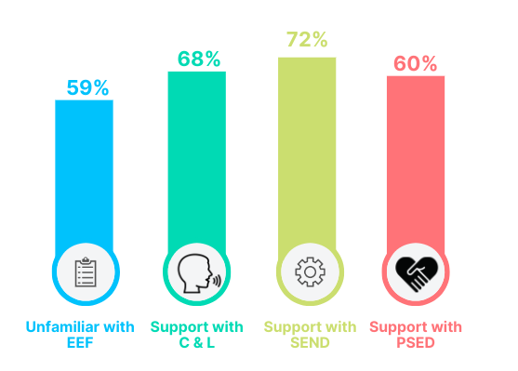
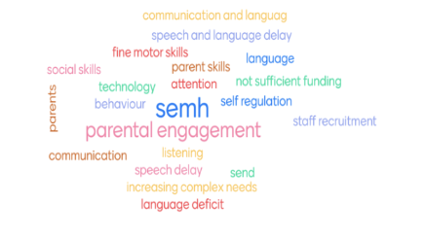
Needs Analysis Audits – Priority Areas Identified
Practitioner & Childminder Needs analysis – key PD priorities areas identified
Voices from the sector Your Northumberland colleagues SPH launch day 2 – shared key priority areas for all LA’s
DfE’s PD funded Packages – Priority to raise profile and signpost funded support offers
EEF Evidence Store - all aspects of the SPH is grounded in evidence informed practice
Notes:
September to December 2023
During this period, in addition to gathering local intelligence, the hub released two needs analysis audits, these were completed by childminders and nursery providers across the three LAs, as part of the SPH launches were being rolled out.
Leaders have used the analysis report alongside the intelligence gathered from LAs. to inform planning content for the GNSPH PD, guidance and support programme offer for 2023/24.
Key priority areas identified & what we did next
1) Signpost and offer PD training linked to evidence informed practice from the EEF’s Evidence store - 73% of CM’s were unaware of the EEF and the Evidence Store and supporting materials
What did we do next ? Hub leads in partnership with TE research school leads, produced the Webinar - An Introduction to EEF and how to navigate / use the Evidence Store. They also produced a SEL case study (also shared as part of GN Launches) using the EEF’s PSED themed document to showcase how to use the EEF’s evidence informed practice and approaches
2)Establish new childminder networks across the 3 x LA’s position in locations of deprivation and in key localities within each LA where no networks were in operation. Audit Info. 2/3 of LA had no formally known CM networks.
What did we do next ? Hub leads began working with 1 well established childminder group in Durham & an external provider ( Hartbeeps). Childminder network Hartbeeps project was planned (50 network sessions planned to be rolled out from late Jan to March 24). this is currently being offered across 3 x LA’s carefully chosen and located in specific LA localities, Hub lead continuing to work with / attending the well established CM group in Durham, and working to raise the profile of using EEF’s evidence informed practices and approaches to childminder to use within the home learning environments / childminder settings.
Sustainability plans - Free resources carefully selected to give to CMs, these are matched to each session focus (linked to a specific EEF theme approaches) to enable CM’s to practice using evidence informed approaches in their learning environment with their children . More planned sessions have been accounted for and planned in next years budget March 24-Oct 24.
3) Hub to offer a regional/ core PD training offer and network group opportunities, to support all settings & CMs to use evidence informed practice to support CL, PSED to support children with SEN. Included the key project Hartbeeps to provide childminder networks, support implementation of EEF evidence informed practice to support CL and PSED)
What did we do next ? Ongoing, hub leads worked with our delivery partners to produce a suite of PD training sessions and network opportunities for spring 1 & 2 where sessions are linked EEF evidence informed practice and partners signpost practitioners to the theory, model practice, and demonstrate the impact of using EEFs materials on practice and children’s outcomes.
Hub leads also reviewed their SM scheduling processes and raised the amount of Social media posts and used the NCB / GNSPH websites to share GN PD offers and networks linked to EEF Evidence Store resources
- DFE Packages of funded support – raised the profile of funded support via SM handles, SPH Launch events and face to face PD and during Network sessions

Slide 53
Childminder Networks – The Hartbeep’s Project
Aims:
-to establish new network groups in key locations across the 3 x LA, to increase the number of childminders attending network groups and to share examples of evidence informed practice
By using a well known local music programme provider, as an initial incentive to encourage childminders to attend network sessions; as network sessions were no longer in operation due to the pandemic
-to use childminder network sessions as an opportunity to sign-post childminders to DfE’s EYER funded package offers e.g. DfE Child Development online modules, the EEF’s list of pre allocated programmes, the EEF’s Evidence Store resources and supporting materials e.g. Help for Early Years providers & Statutory Framework for EYFS childminders 2024.
By using these sessions as an opportunity for the Hartbeep’s programme session leaders to model evidence informed approaches linked to the EEF’s Evidence Store materials when delivering sessions; to upskill the childminder workforce, in how best support children’s communication and language development by implementing EEF’s evidence informed practices.
Notes:
Challenges:
- No networks – used HB’s as an incentive to initial engage childminders in networking sessions – sessions also include planned activities where practitioners model interaction strategies linked to the EE’s Evidence Store, evidence informed approaches to support children with communication and language difficulties
-Childminders spread over a large geographical area -
-making training accessible for all CMs. CM’s requested a range of different training times to be offered – am / pm sessions, after school, Saturday mornings and during holidays training sessions

Slide 54
EEF Evidence Store - Evidence Informed Practice and Approaches
Notes:
Here is an example of how EEF’s guidance reports and materials from the Evidence Store have been shared with childminders and EY practitioners.
The GNSPH has rolled out a childminder project across their 3 LA’s targeting the most deprived areas, in attempt to establish new childminder networks and to share evidence informed best practices linked to how best to support children’s with communication and language delay / difficulties
Hub leaders made the decision to use a regional company (Hartbeeps - who deliver musical and dance sessions for early years children. focused on rhymes, songs and storytelling), to use as an incentive to encourage childminders to attend regular networks and have opportunities to network with other childminders and share best evidence informed practice.
Hub leads worked with Hartrbeep delivery leads to ensure session are carefully planned and delivery leaders model strategies during the music sessions, that are linked to some specific evidence informed approaches from the EEF’s Communication and Language themed document, and some key recommendations from the EEF’s Preparing for literacy report.
Information leaflets are given out to childminders after the session to provide further information related to:
- how the EEF approaches were used during that session
-the GN Hub Wider PD offers, including the NCB GNSPH website, blogs and case studies https://www.strongerpracticehubs.org.uk/hubs/ne/great-n-eysph/events
- information and links to sign up to the GN Childminder Facebook Group page
- information and further direct weblinks EEF Communication and Language Themed documents and guidance report recommendations
https://educationendowmentfoundation.org.uk/early-years-evidence-store/communication-and-language
EEF preparing for literacy report
https://educationendowmentfoundation.org.uk/early-years-evidence-store/communication-and-language

Slide 55
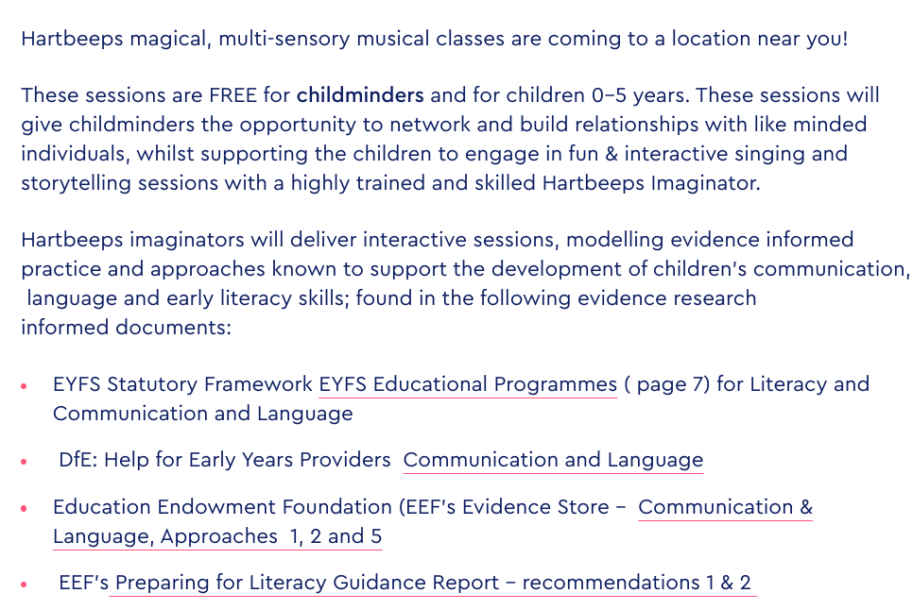
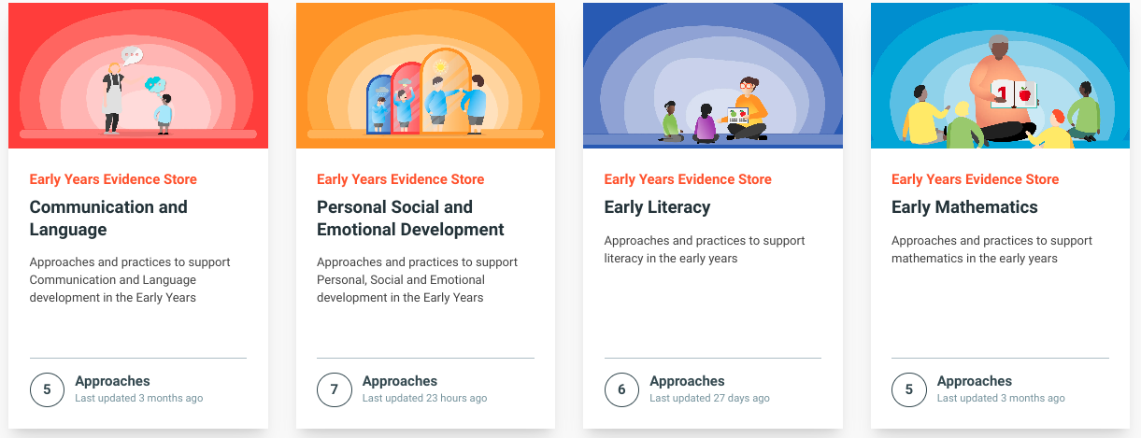
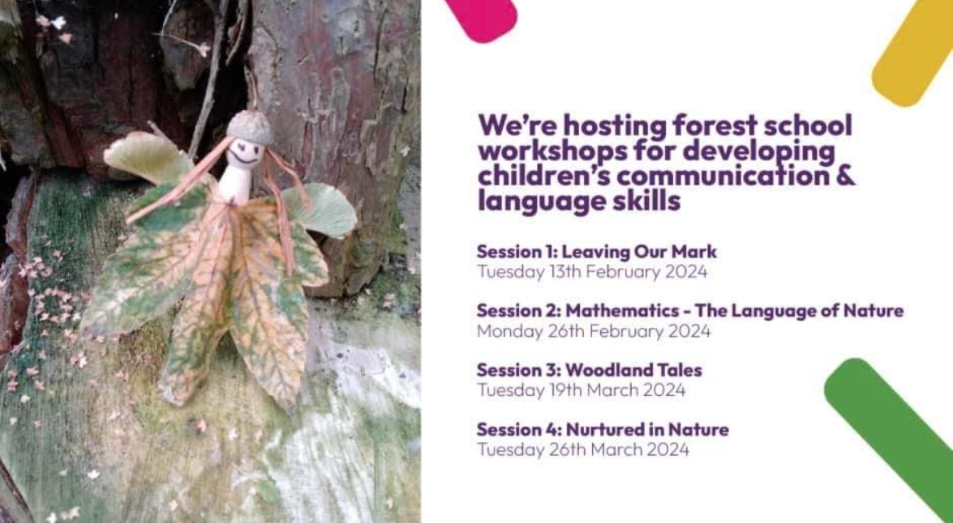
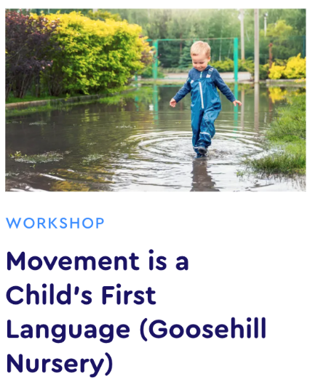
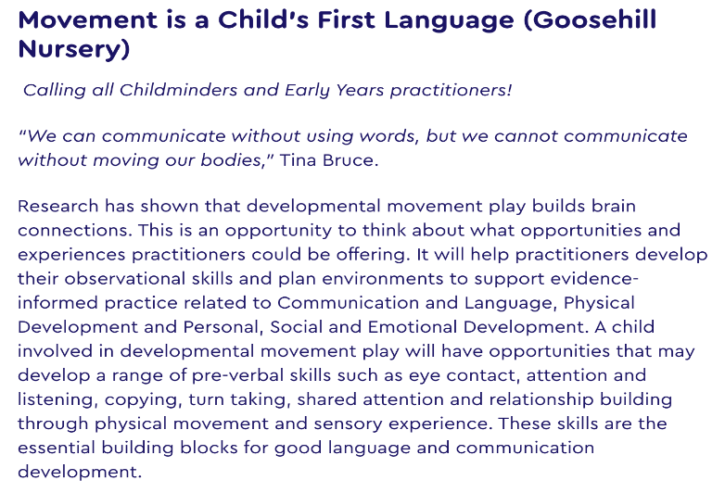
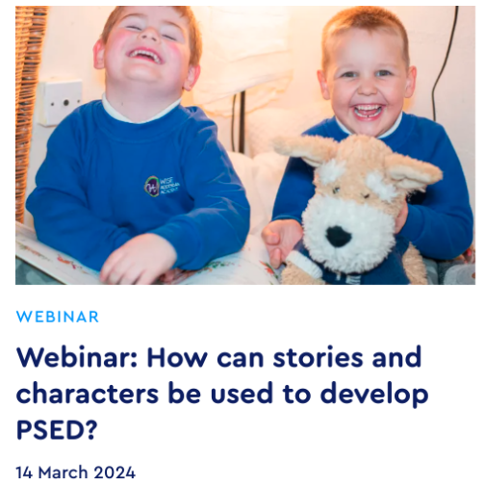
The GN PD Programme Offer 2024
Hartbeeps session. “We’ve had a fantastic morning at Lanchester today. I liked the way the session had a structure to it with a singing and rhyme session but also included a section where children had opportunities to interact with their peers and CM’s could find out more about what the SPH has to offer” Childminder Feb 24.
Working in partnership with TE Research school
Goosehill session:
“Can I just say how absolutely amazing this opportunity is to work with your group. It’s so refreshing to have training that understands the needs and challenges of childminders. To have hands on training opportunities where we can bring our children along to enjoy the experience together is an absolute game changer. To have courses that are fun and bring all sectors of childcare together to learn from each other and share knowledge and skills. My only wish would be that it continues after the covid recovery finances run out so this style of sharing best practice is continued” Childminder Marie Hume, Facebook, Feb 24.
Notes:
The GN wider PD programme 2024 offer. NCB / GNSPH website event links: https://www.strongerpracticehubs.org.uk/hubs/ne/great-n-eysph/events.
Examples of additional PD sessions, building a wider PD offer alongside the childminder’s Hartbeep’s session; to signpost CMs and practitioners to key supporting DfE documents, e.g. Dev. Matters, Statutory Framework for EYFS 2024, Help for Early Years providers,
Continued PD focus on CL
A series of Forest school sessions for childminders & PVI / EY nursery practitioners, focused on supporting language development, threaded through each session linked to an evidence informed approach from one of the four EEF themes e.g.
Session 2 EEF Early Mathematics - approach 5, facilitating mathematical language
Session 3: EEF’s Communication and Language - approach 2, teaching and modelling language
PSED SEL case study / rolled out in launches and additional SEL PD training days sessions – focus using specific language to express feelings.

Slide 56
Hub Successes
establishing effective partnerships and working in collaboration with a range of stakeholders
working in partnership with TE research school, English hub and strategic partners to produce exemplification of evidence informed best practice
working with strategic partners to create the GN SPH professional development programme 2023/24 to compliment and bespoke to the needs of each LA offer
using social media to increase the number of childminders and EY practitioners engaging with EYER funded support package offers
meeting hub recruitment numbers & increasing numbers of practitioners engaging with EYER funded package offers
increasing numbers of requests received by EY professional teams offering to deliver PD training, guidance and support on behalf of the GNSPH professional development programme offer 2023/24
working with strategic partners & local authorities to produce a SPH sustainability plan
Notes:
-establishing and developing effective partnerships, e.g. local authorities, strategic partners, EYs professional teams, practitioners and childminders (voices from the sector); working together in collaboration to inform PD content and deliver training, offering support and guidance to upskill all EY providers types
- working in partnership with research schools, English hubs & delivery partners to produced case studies and deliver training to support the EY workforce; to implement evidence informed practices using the Evidence Store materials; to improve practitioners EY practice, ensuring more children achieve expected outcomes on exit from reception.
- planning the hubs PD training programme offer 2024 for childminders /all providers types across all 3 LAs linked to the key priorities identified in provider Needs analysis audits in autumn 2023.
- social media advertising - increasing numbers of subscribers to the GN hub (345 individuals) & daily increases on followers on Facebook, X, Instagram & Linkedin
- meeting Hub recruitment targets for pre allocated evidenced informed programmes raised profile and increased numbers of providers accessing the DfE PD packages of support
- hub receiving an increase in EoI from professionals working to support settings in the early years sector, as part of specialised teams e.g. AET, Dingley’s Promise etc.
- producing ideas for a sustainability plan after SPH project ends in Oct. 2024, by building on the successes of the hub
..

Slide 57
Workshop 1
Theresa Johnson
Programme Lead – Early Childhood Unit National Children’s Bureau

Slide 58
Workshop 1
SEND
Working with Childminders
Supporting Children with Speech, Language and Communication

Slide 59
Break

Slide 60
Workshop 2
Establishing and maintaining effective partnerships that make the hub most impactful
Showcasing Evidence based practice
Supporting Professional Development

Slide 61
Q&A session

Slide 62
Evaluation

Slide 63
Thank You
https://www.strongerpracticehubs.org.uk/
sph@ncb.org.uk

